Slide 1
HOME Graphics to support Dissemination and implementation
These graphics have been created to allow members of HOME to share information about the HOME Core Outcome Set
Please feel free to use these graphics in your presentations and publicity materials
If using, please add a copyright notice: ©University of Nottingham,2023

Slide 2
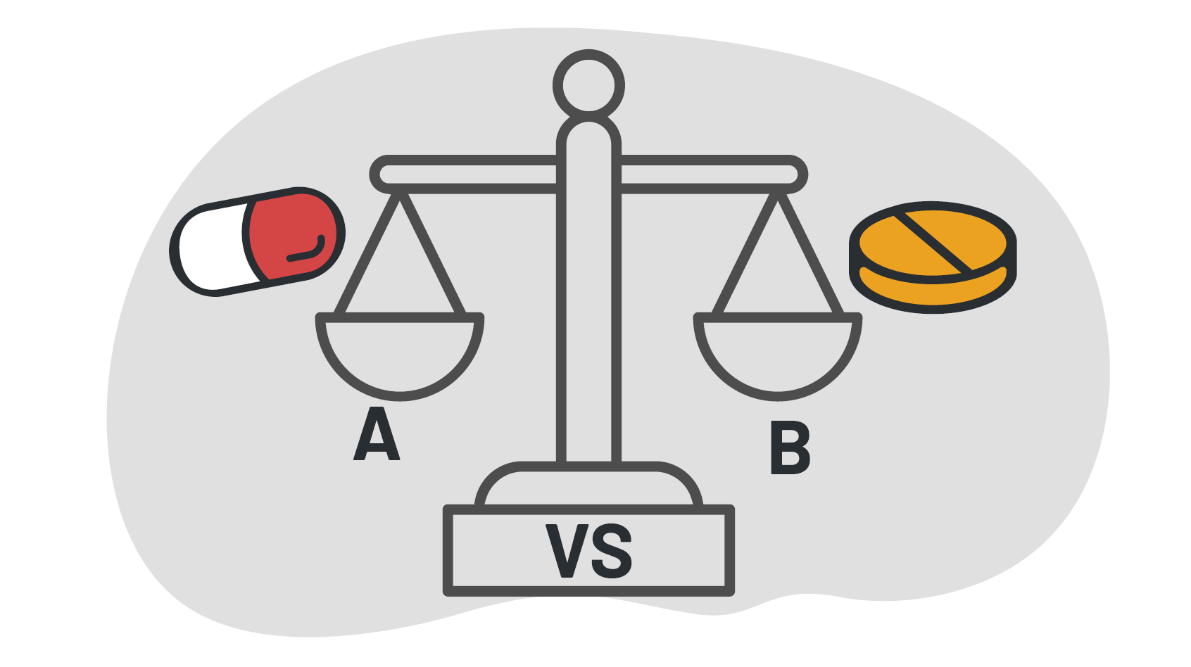
Trials – which works best?

Slide 3
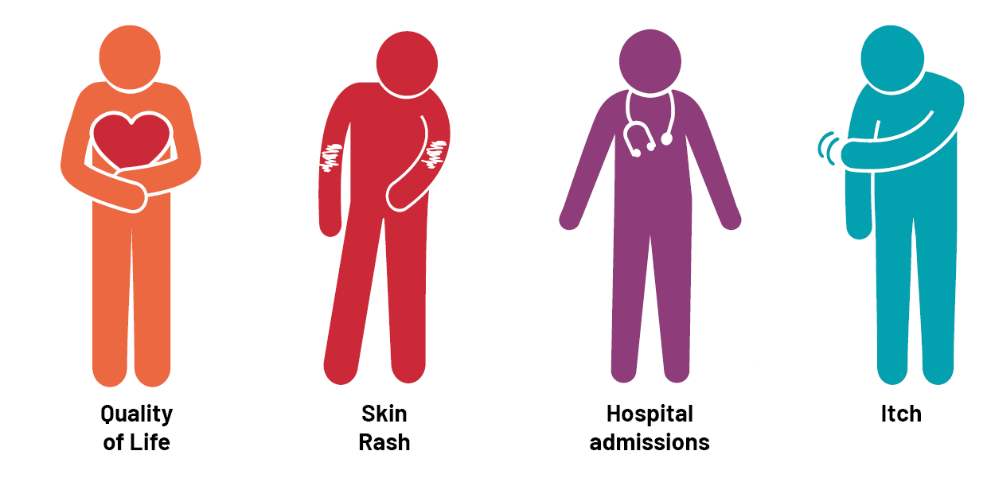
Outcomes – things measured in trials

Slide 4
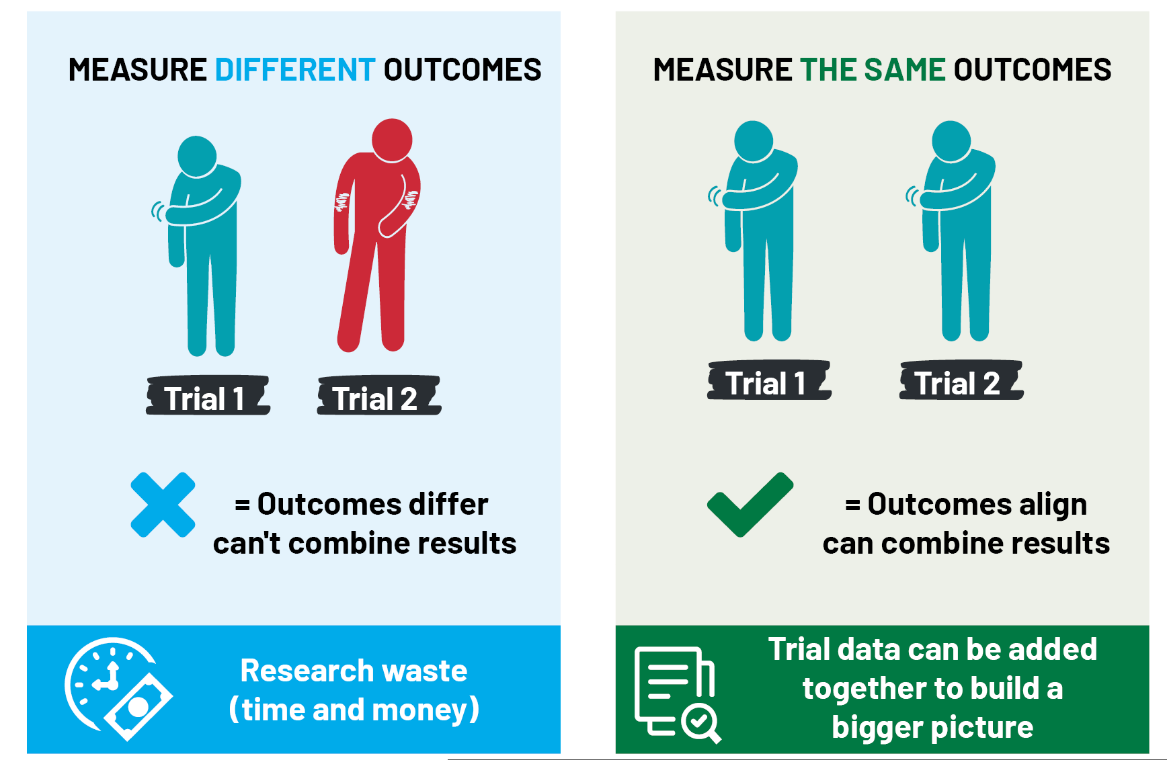
Outcomes – things measured in trials

Slide 5
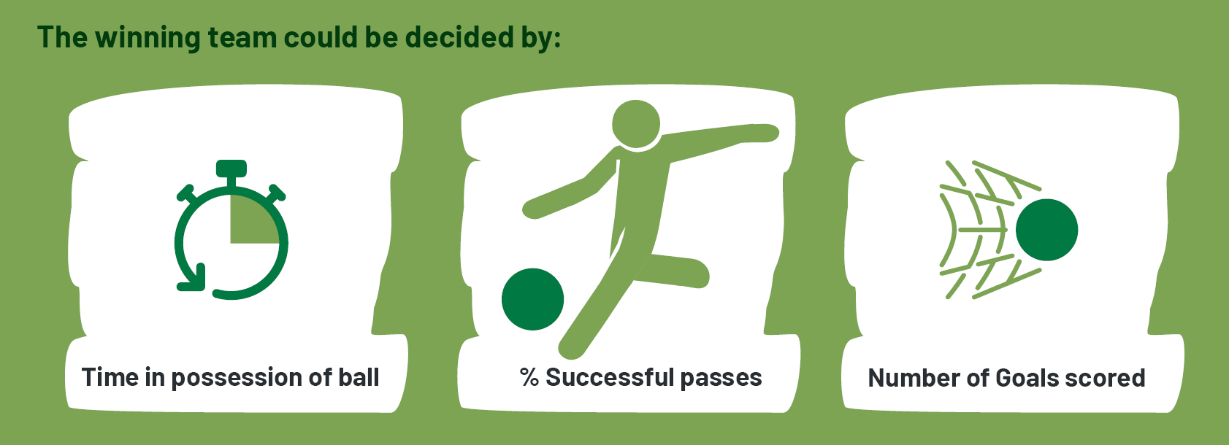
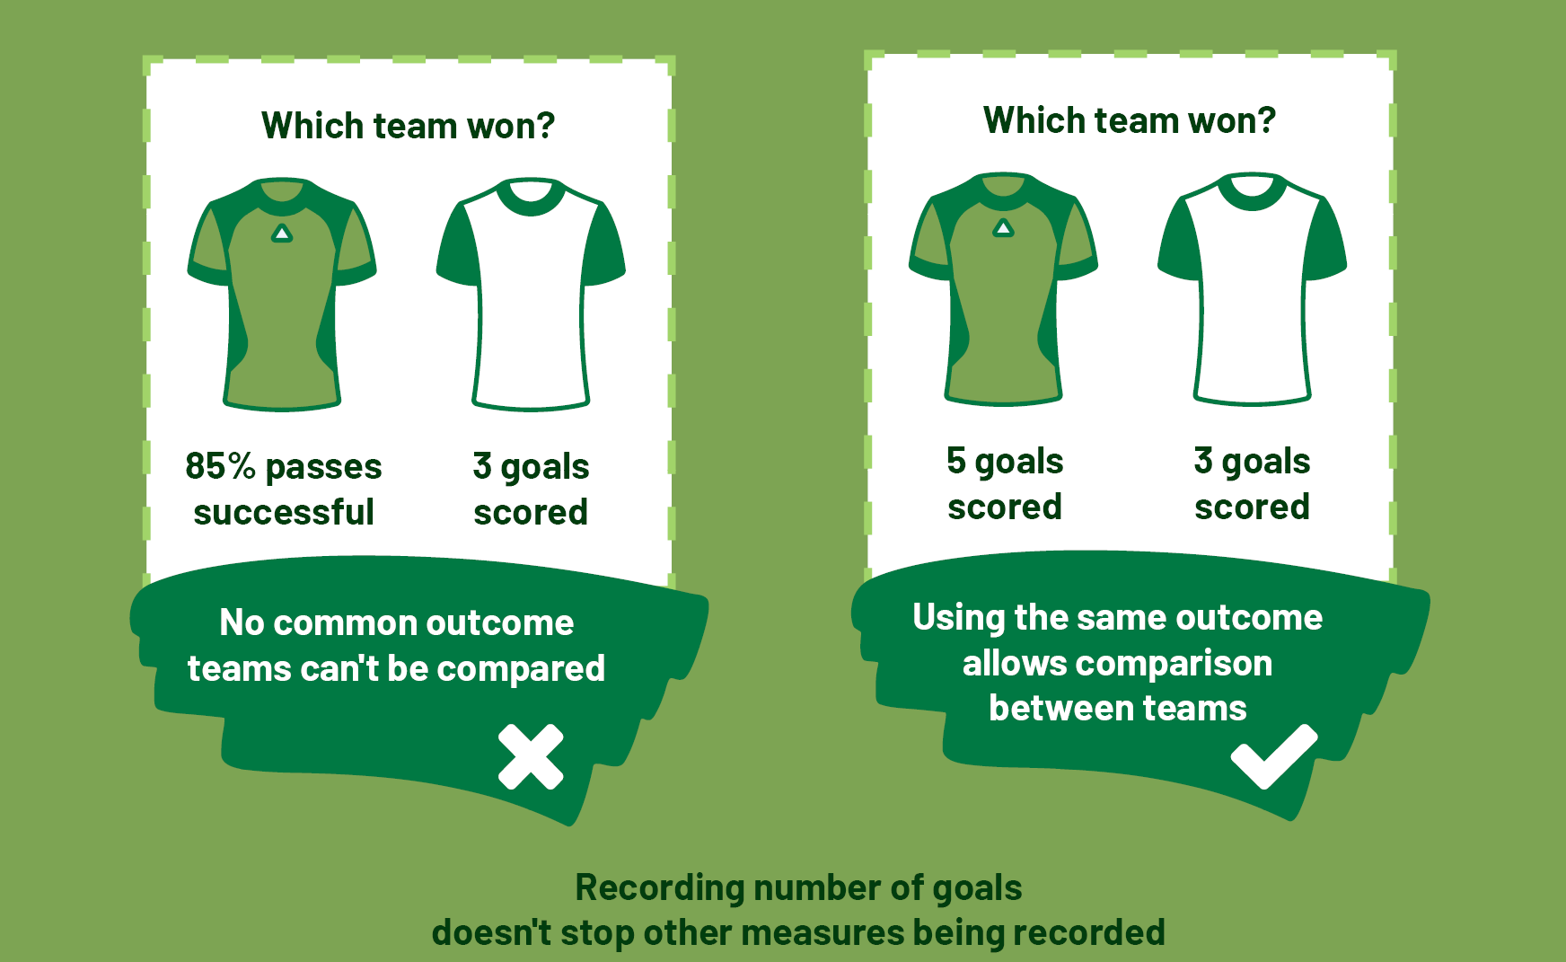
The football (soccer) comparison

Slide 6
Outcomes

Slide 7
What should we measure?

Slide 8
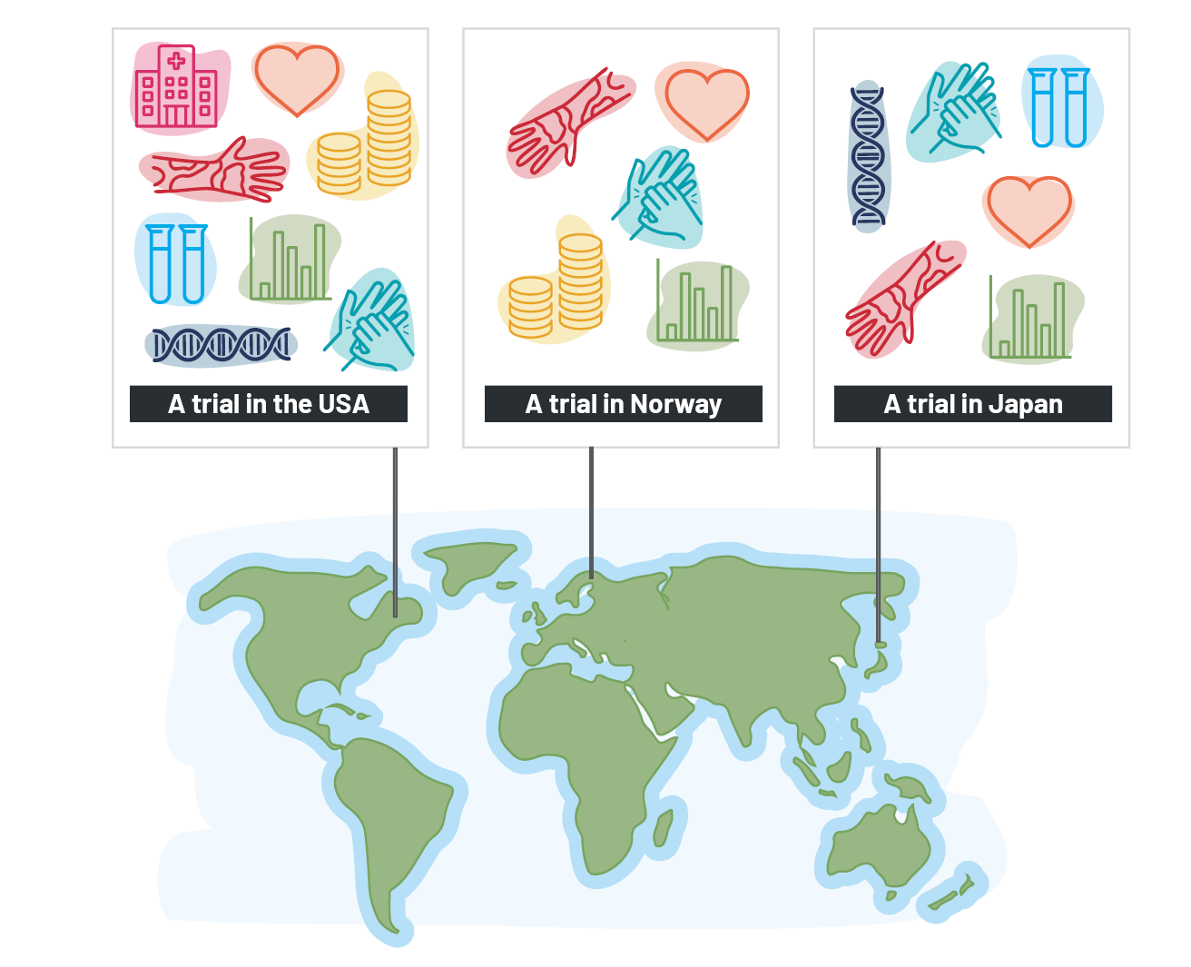
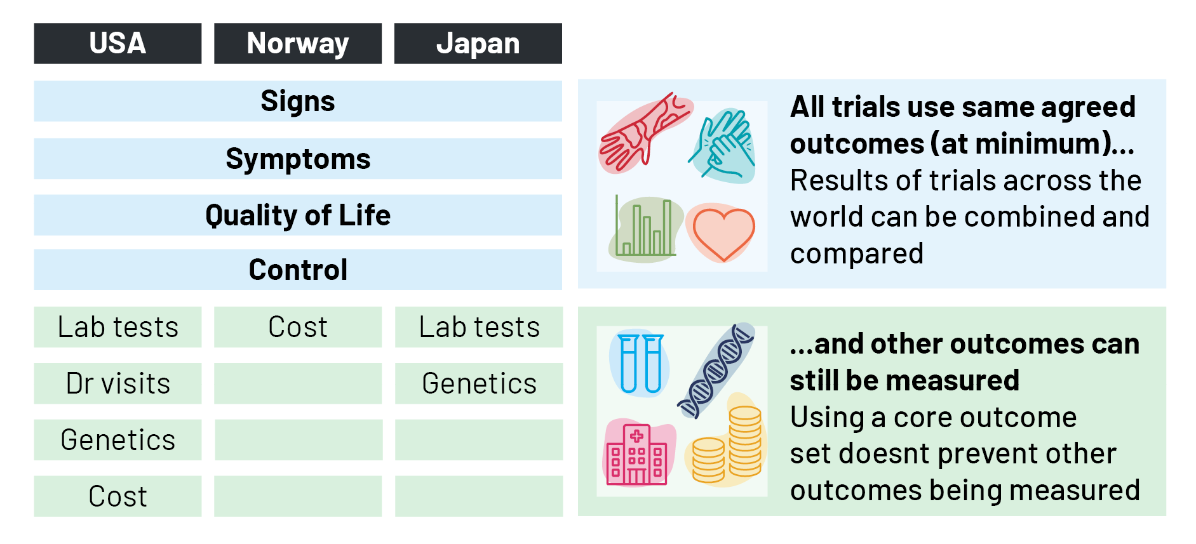
How core outcome sets work (icon version)

Slide 9
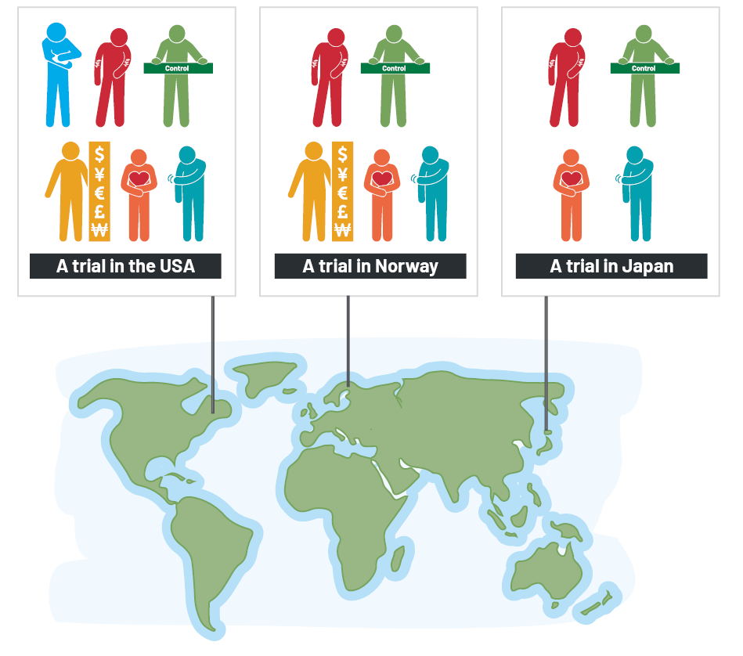
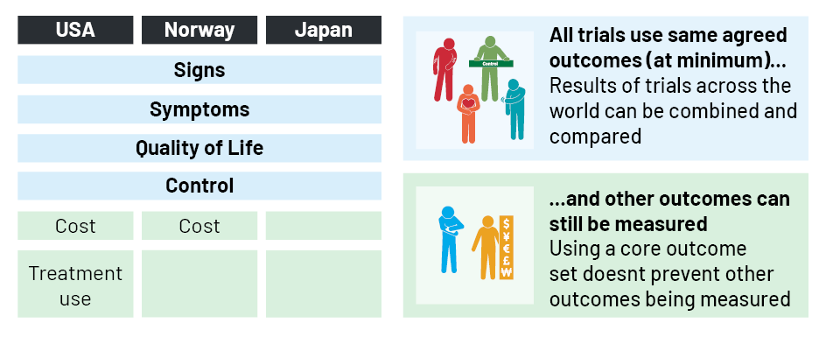
How core outcome sets work (people version)

Slide 10
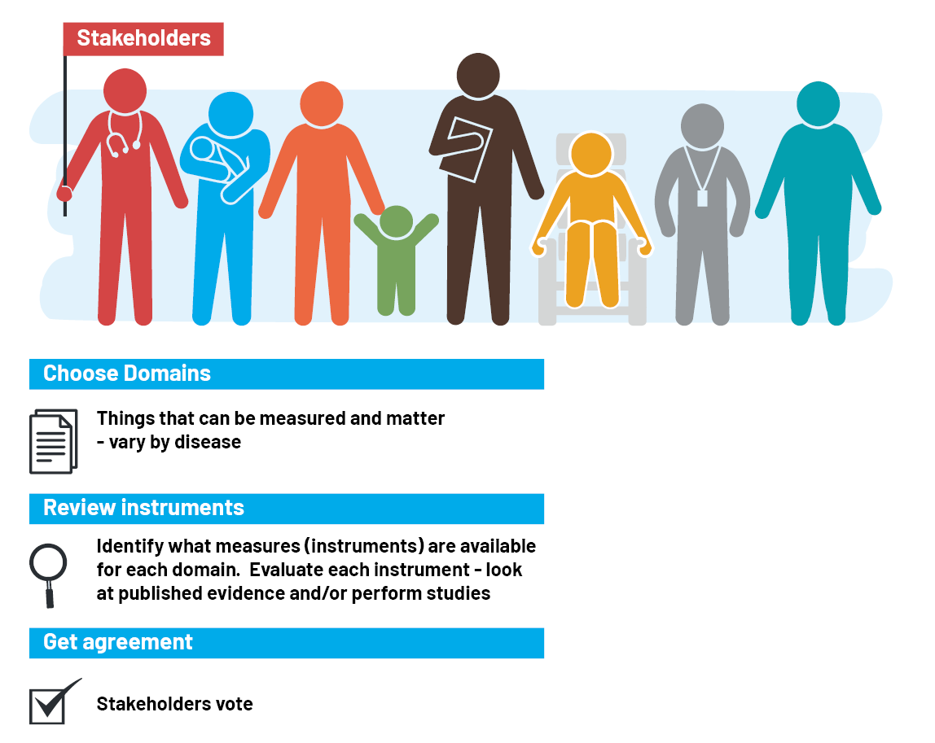
Creating Core Outcome Sets

Slide 11
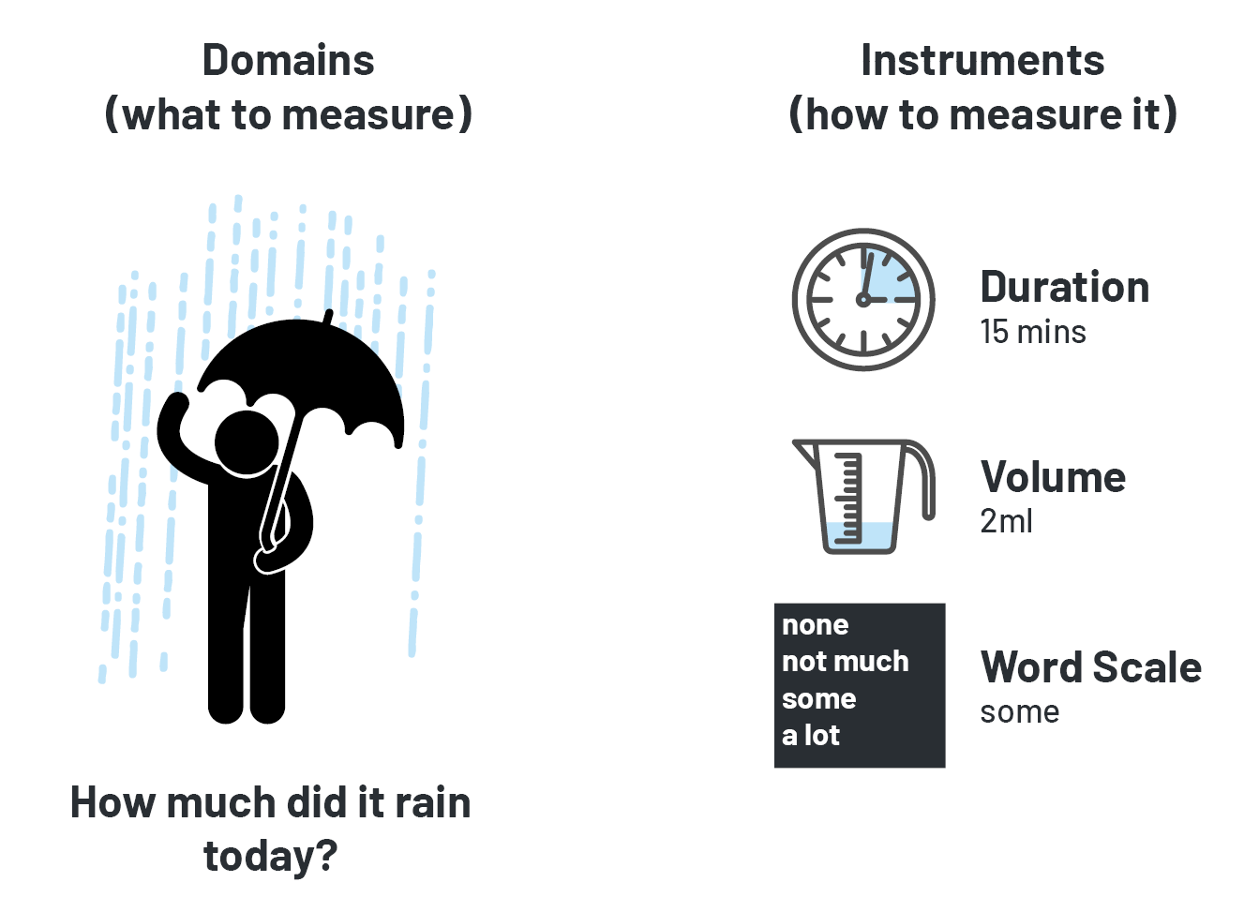
What are instruments?

Slide 12
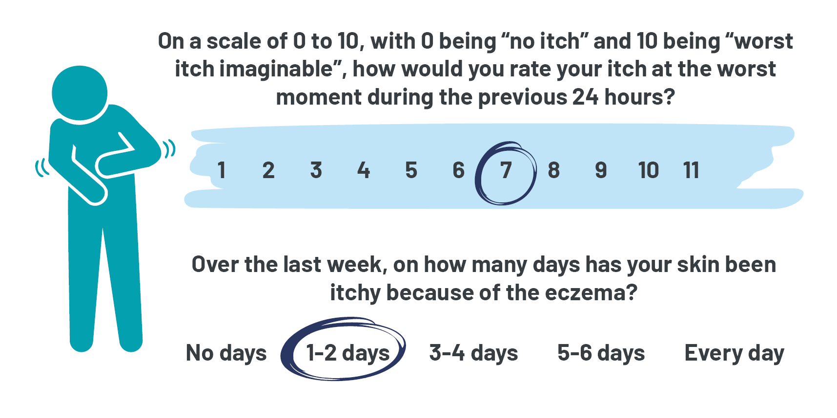
What are instruments?

Slide 13
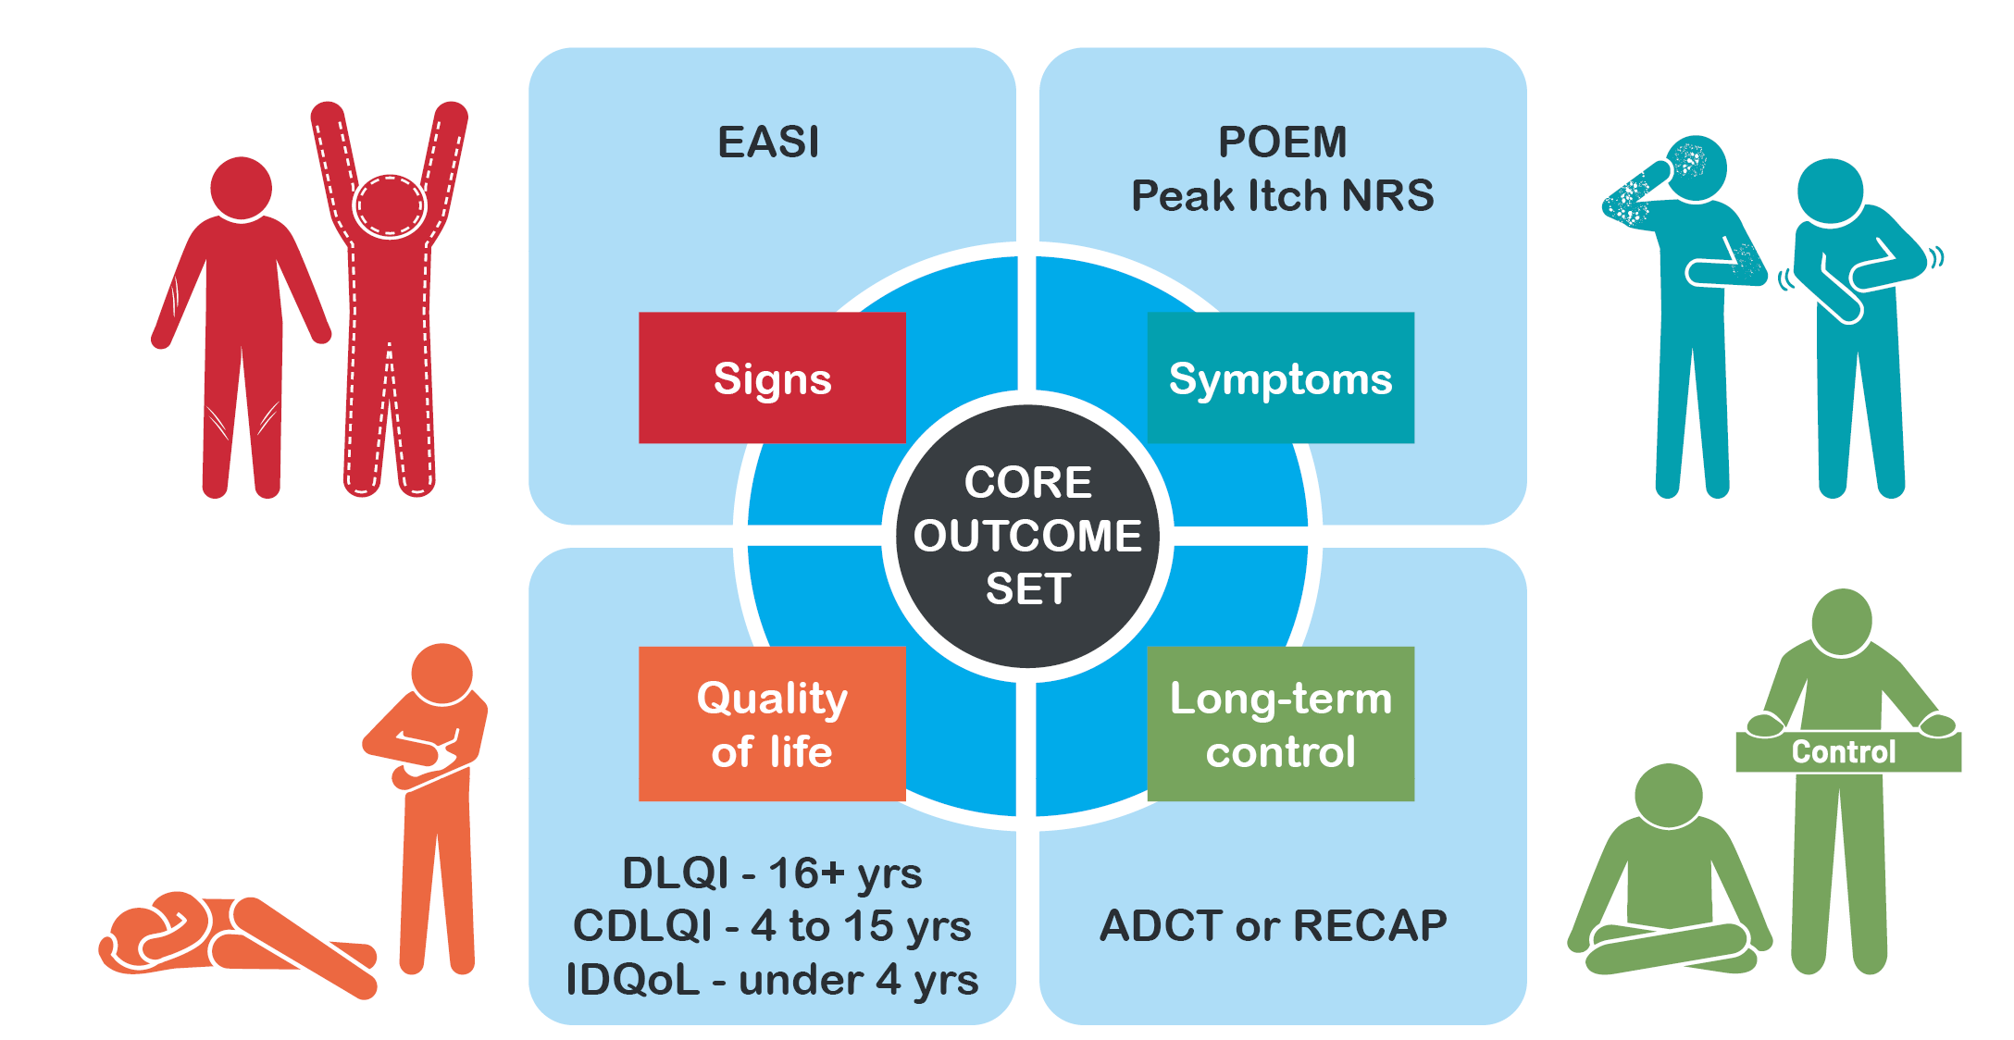
HOME Core Outcome Set

Slide 14
HOME Dissemination and implementation

