Slide 1
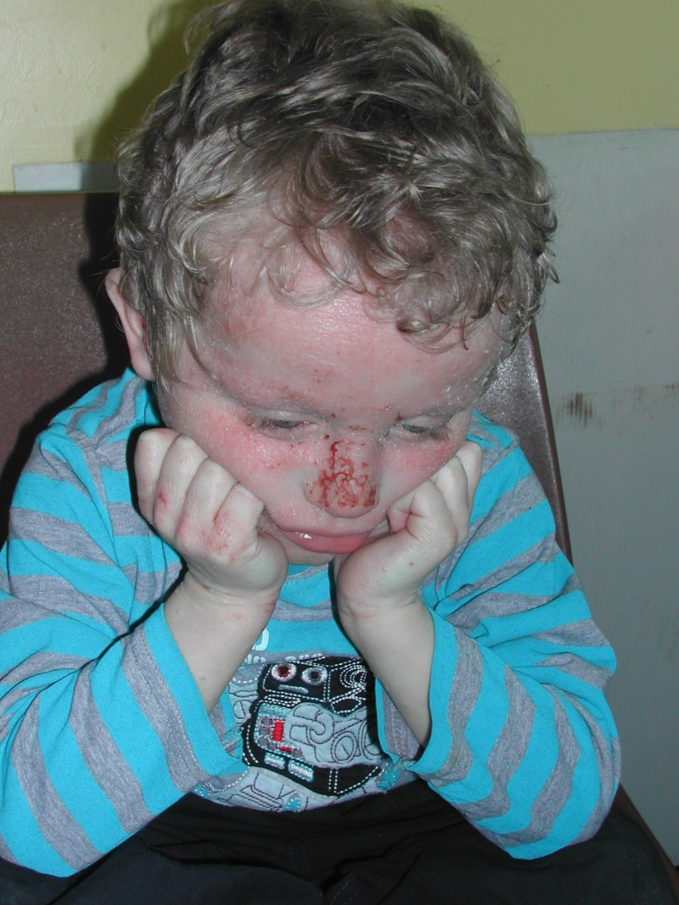
EASI practice images

Slide 2
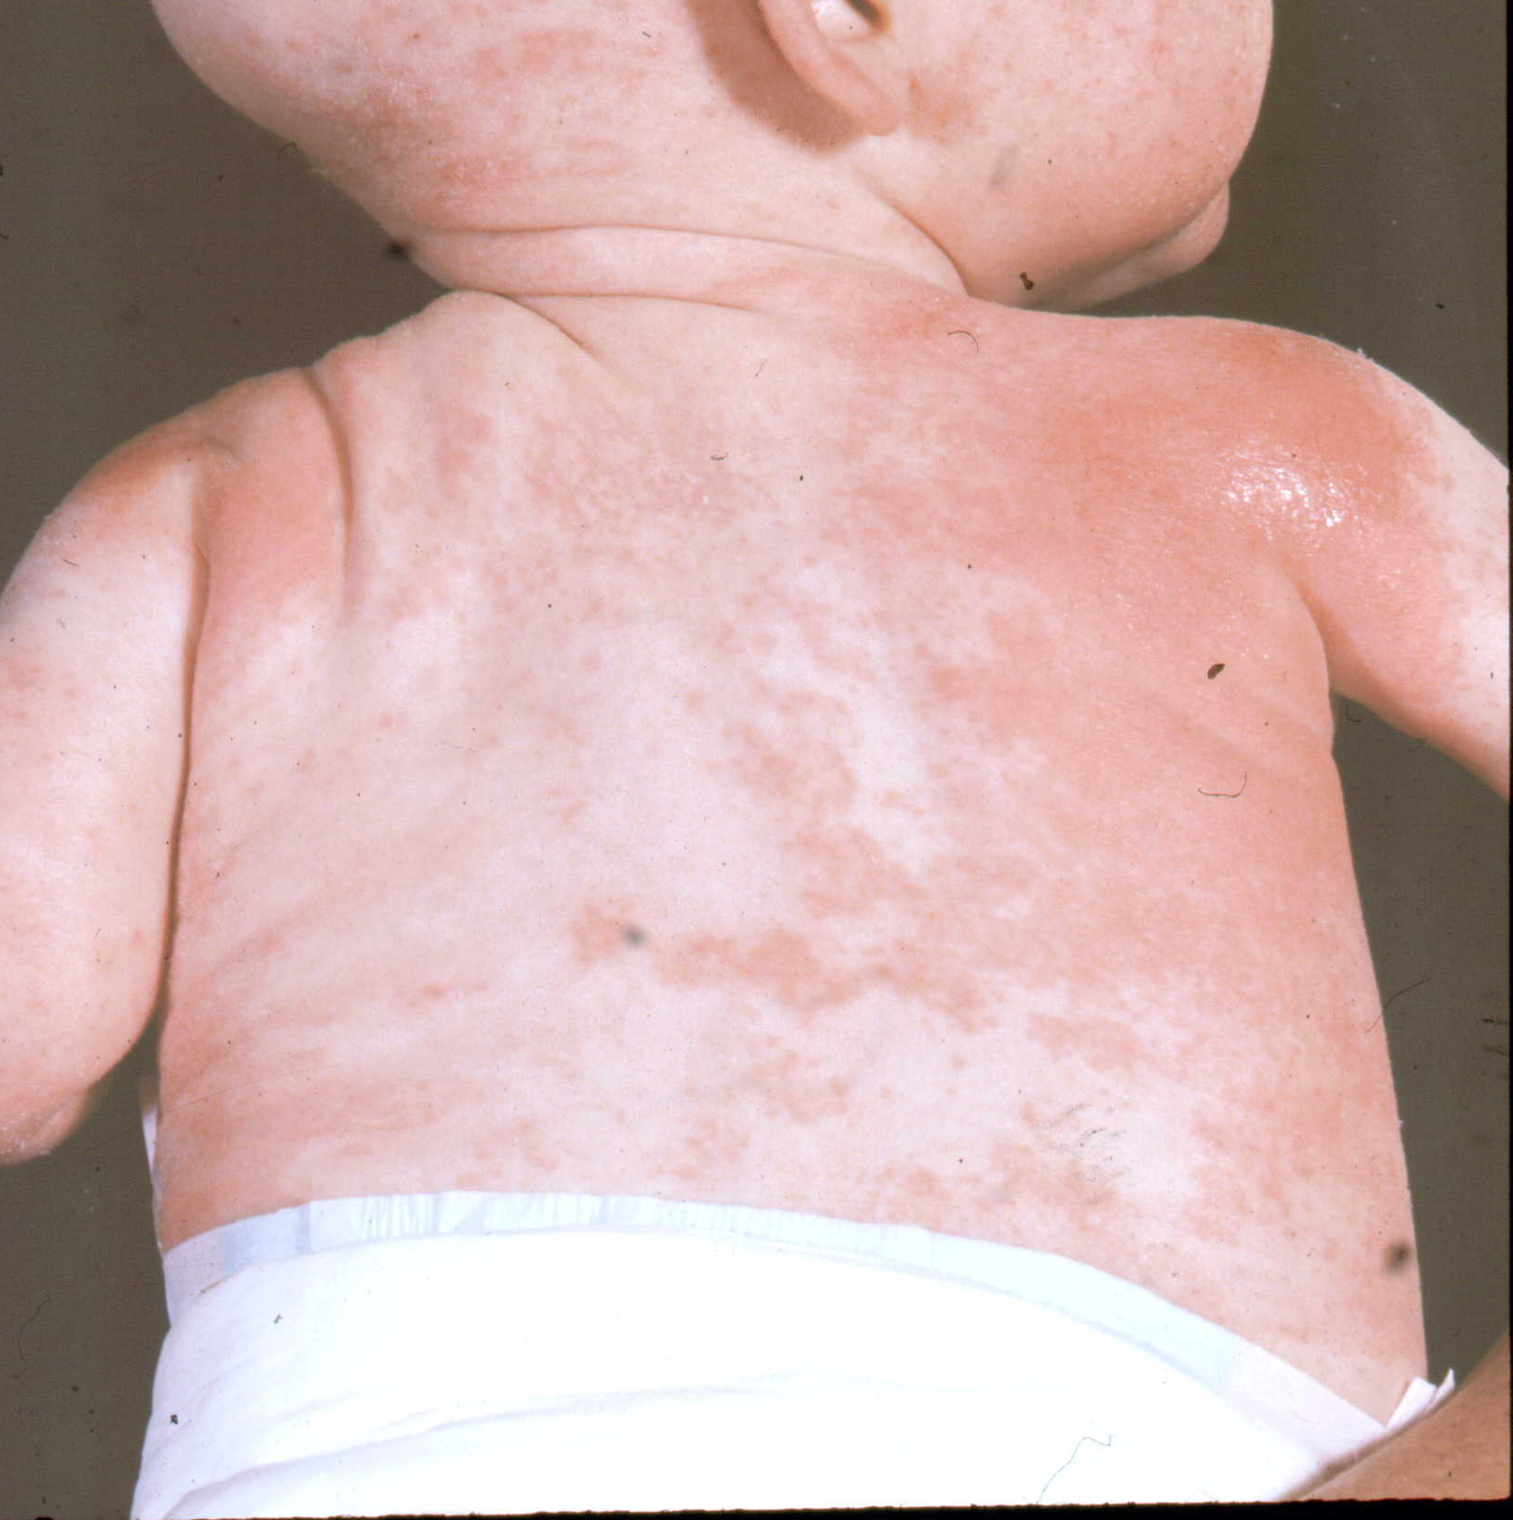
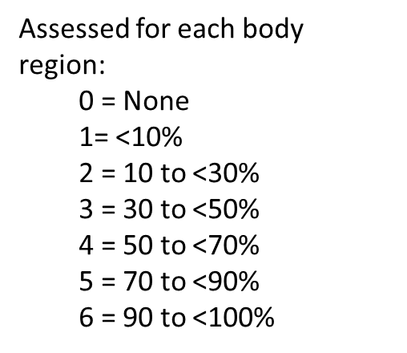
Start with some body surface area

Slide 3
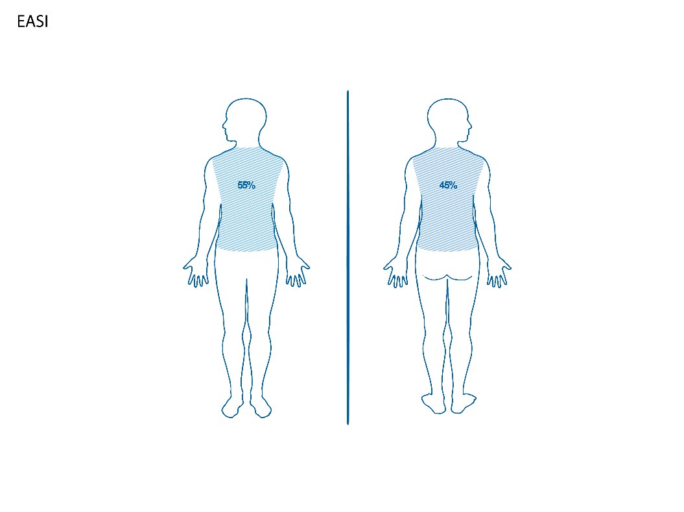
Trunk

Slide 4
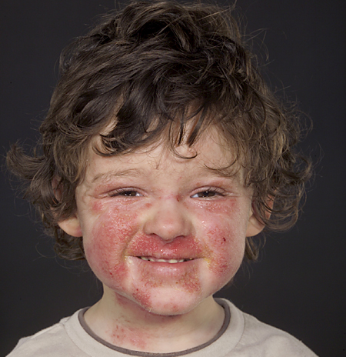

Slide 5
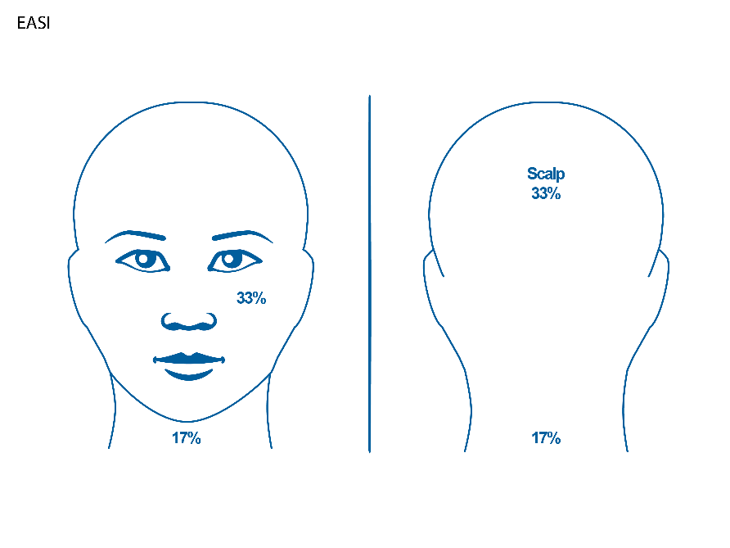

Slide 6
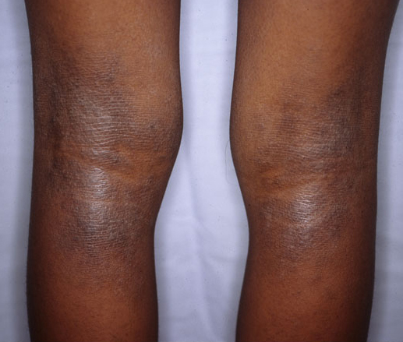

Slide 7
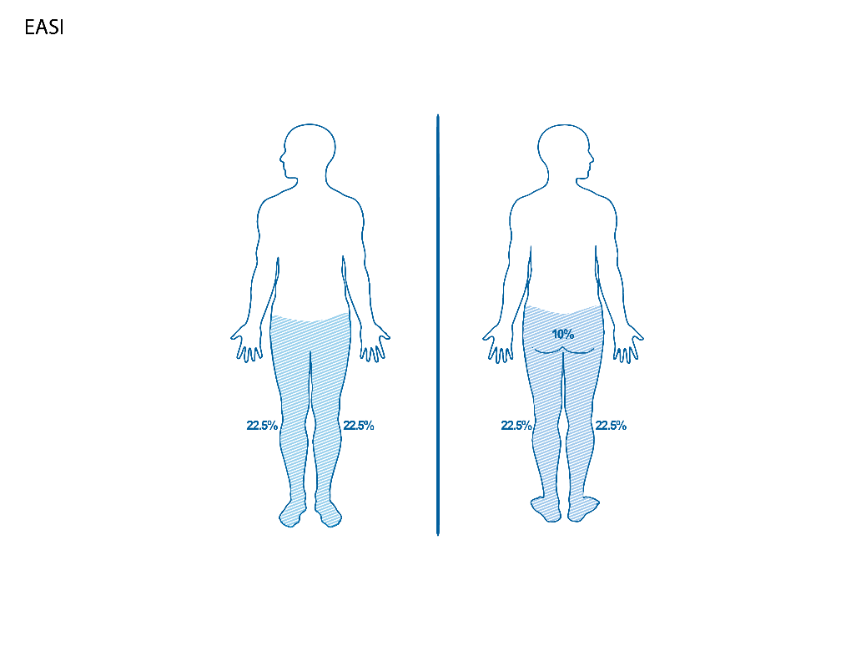
Lower extremities

Slide 8
Assess severity of 4 key signs in each body region
        Erythema (redness)
        Oedema / papulation (swelling and bumpiness)
        Excoriation (scratch marks)
        Lichenification (“leatheriness”)
Score the degree of severity of each sign for each body region separately
Take an average of the severity across the involved area Half points may be used e.g. 2.5 except when averaging 2 limbs 0.5 not used – either 1 or 0 Palpation may be useful in assessing oedema/papulation as well as lichenification
0 | None
1 | Mild
2 | Moderate
3 | Severe

Slide 9
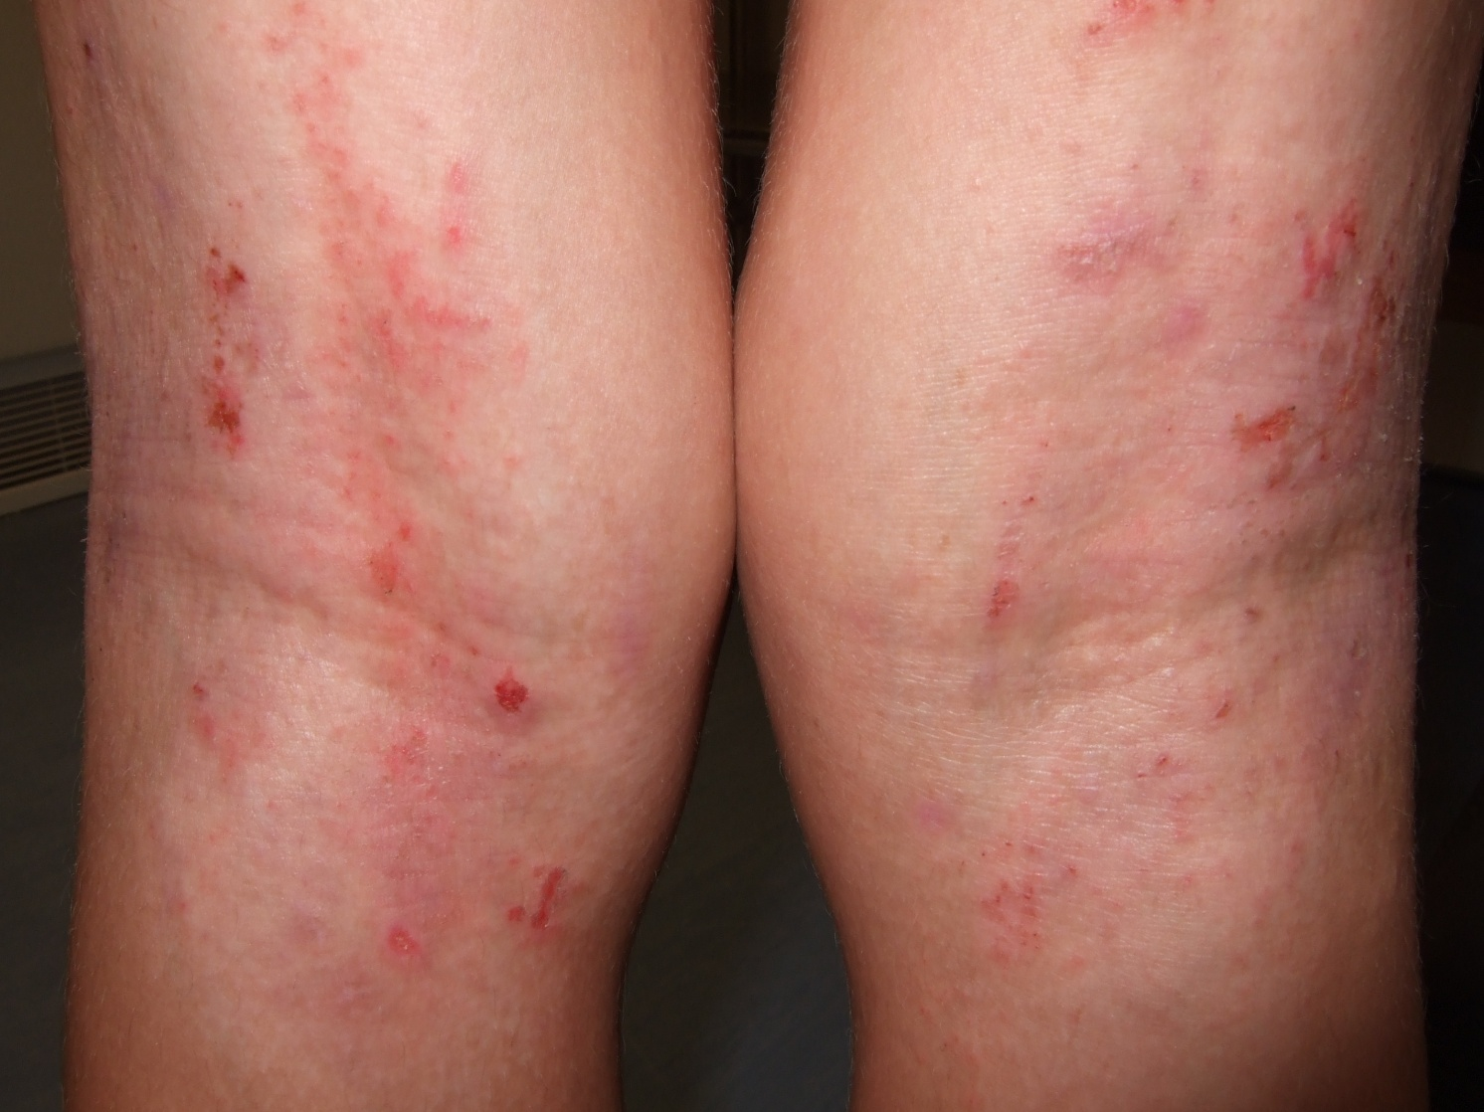
Let’s do the 4 intensity sign

Slide 10
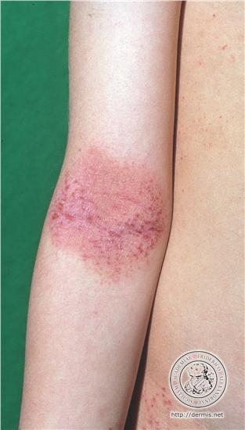

Slide 11
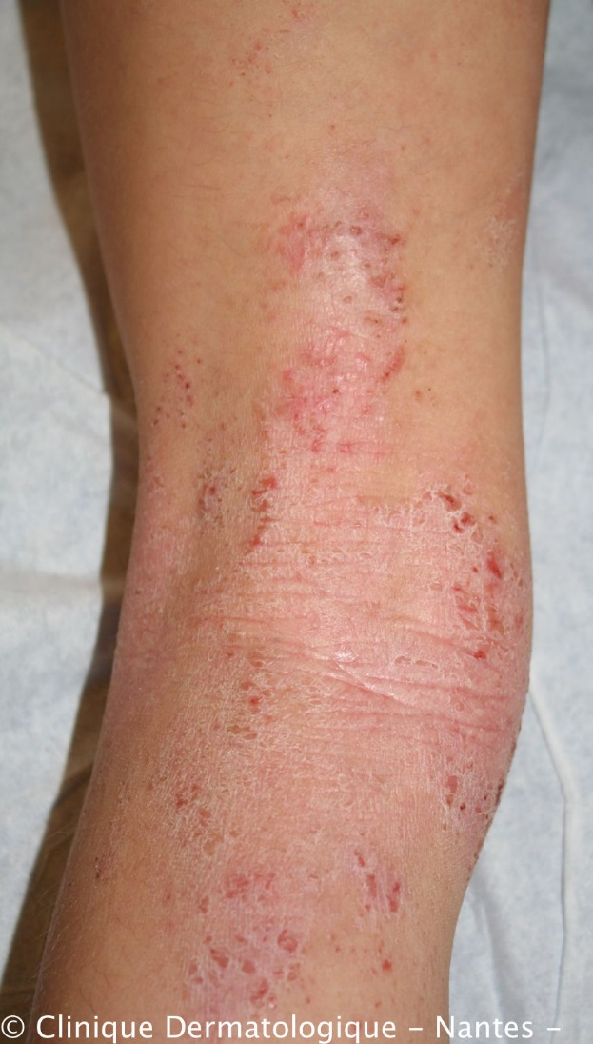

Slide 12
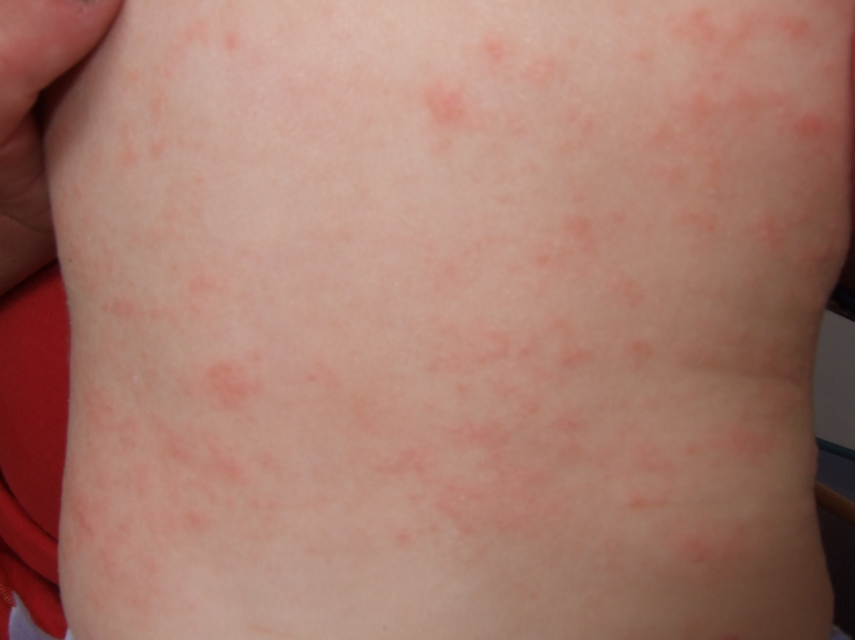
Now you try some: Slide 1:

Slide 13
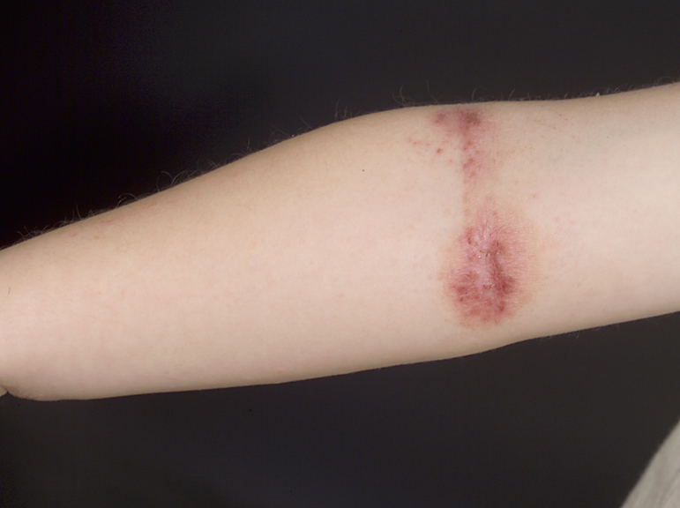
Slide 2

Slide 14
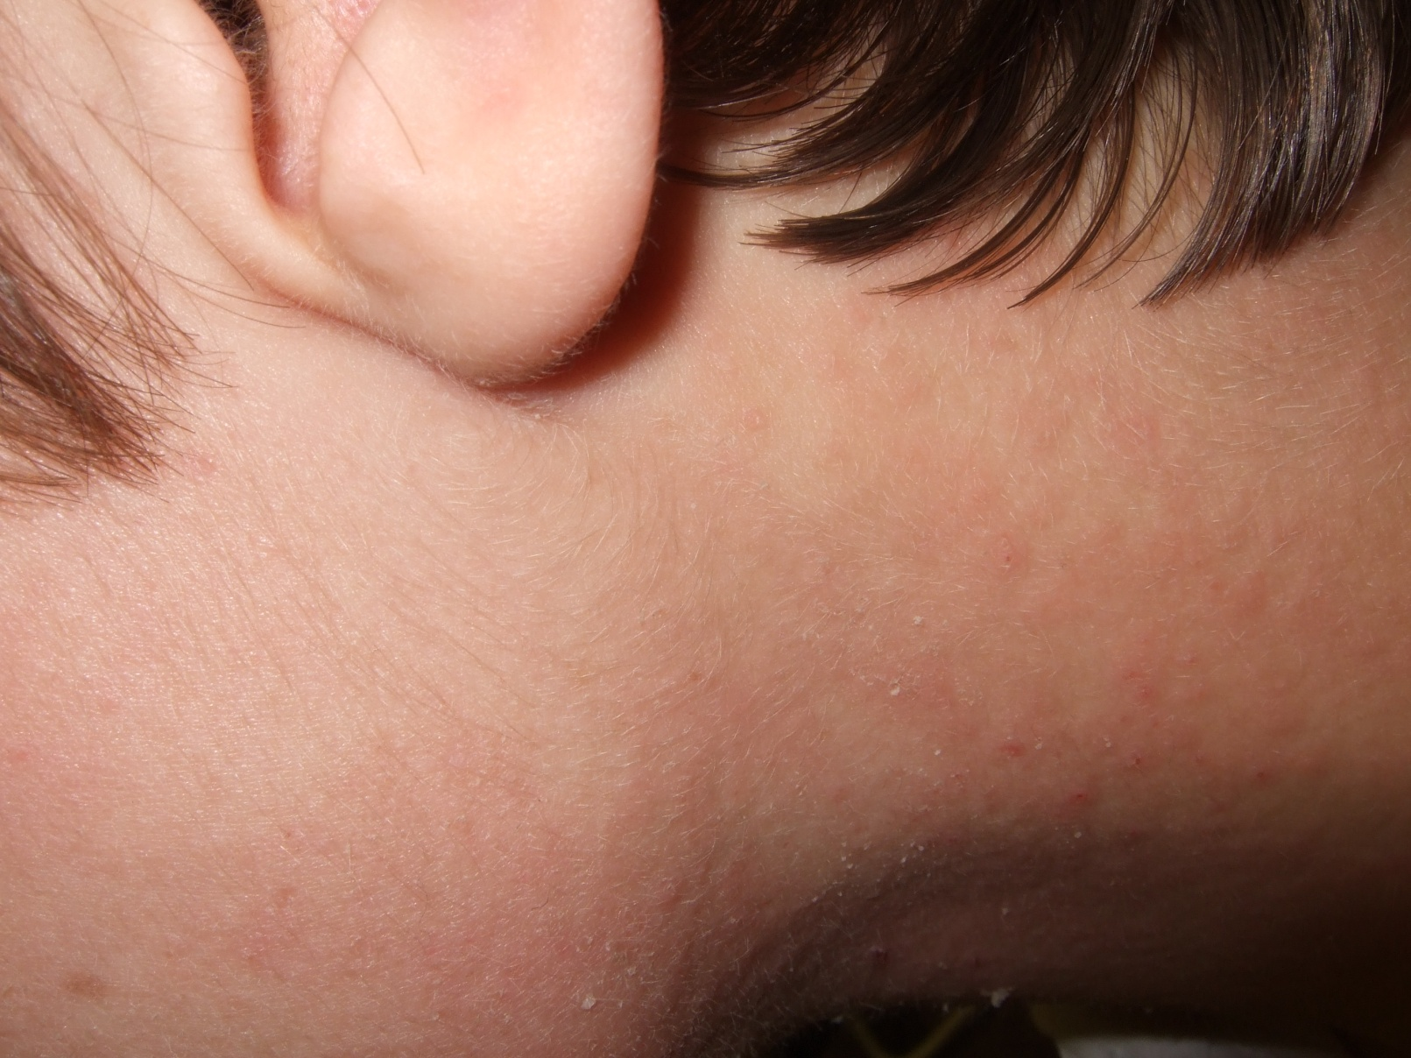
Slide 3

Slide 15
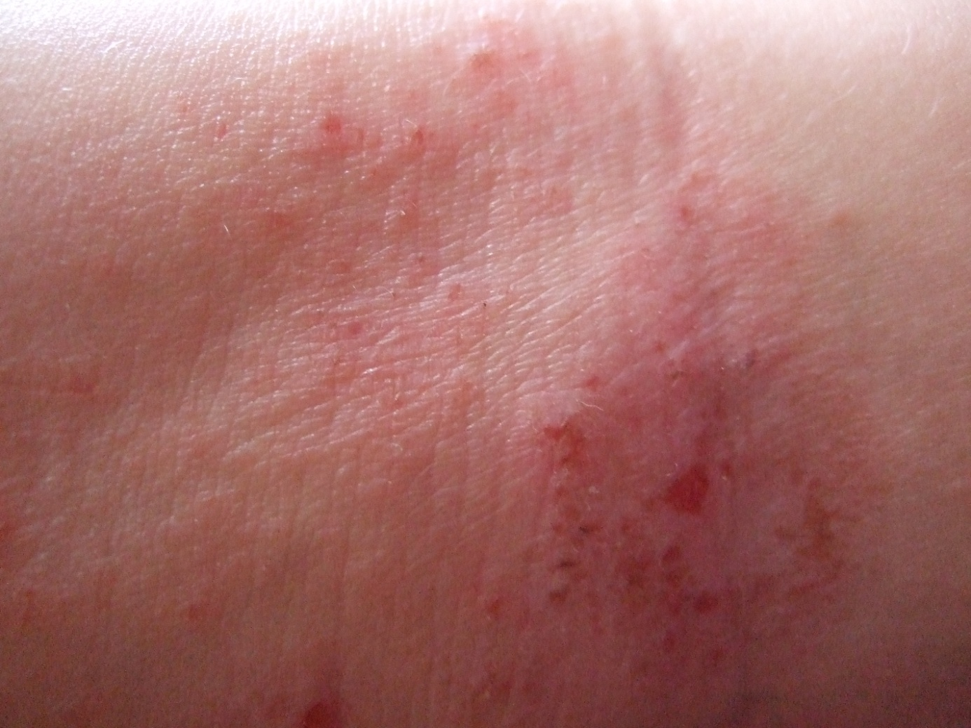
Slide 4

Slide 16
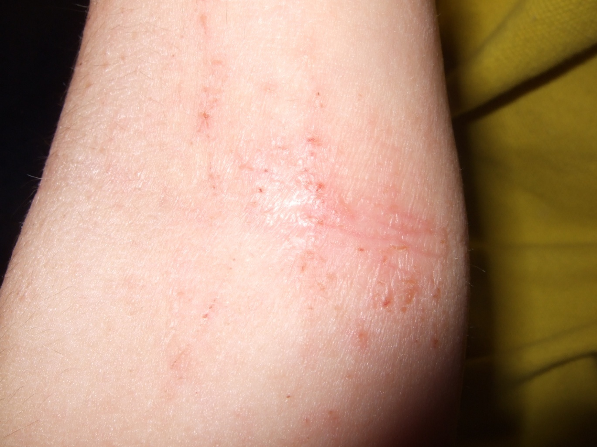
Slide 5

Slide 17
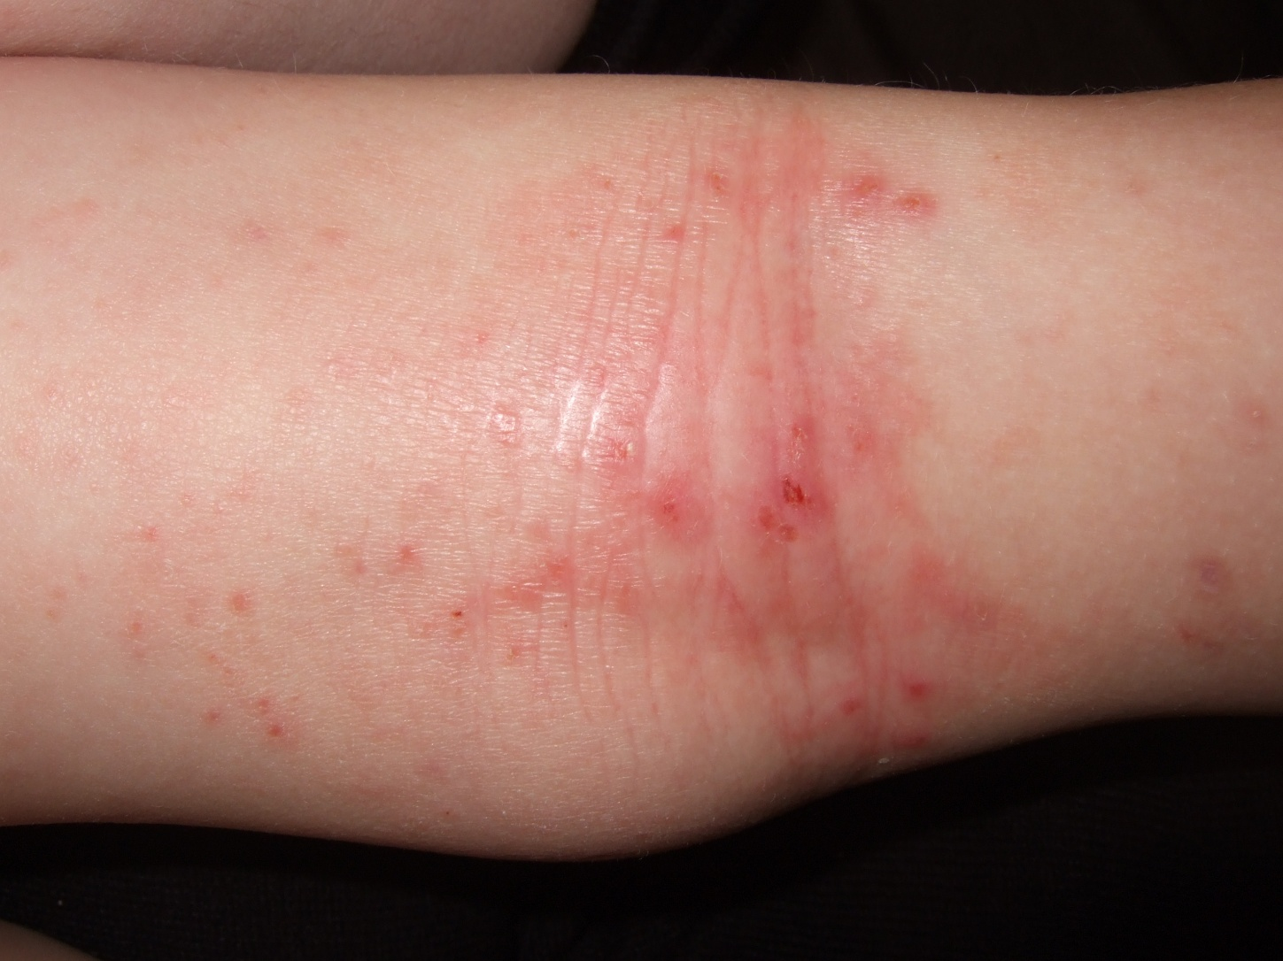
Slide 6

Slide 18
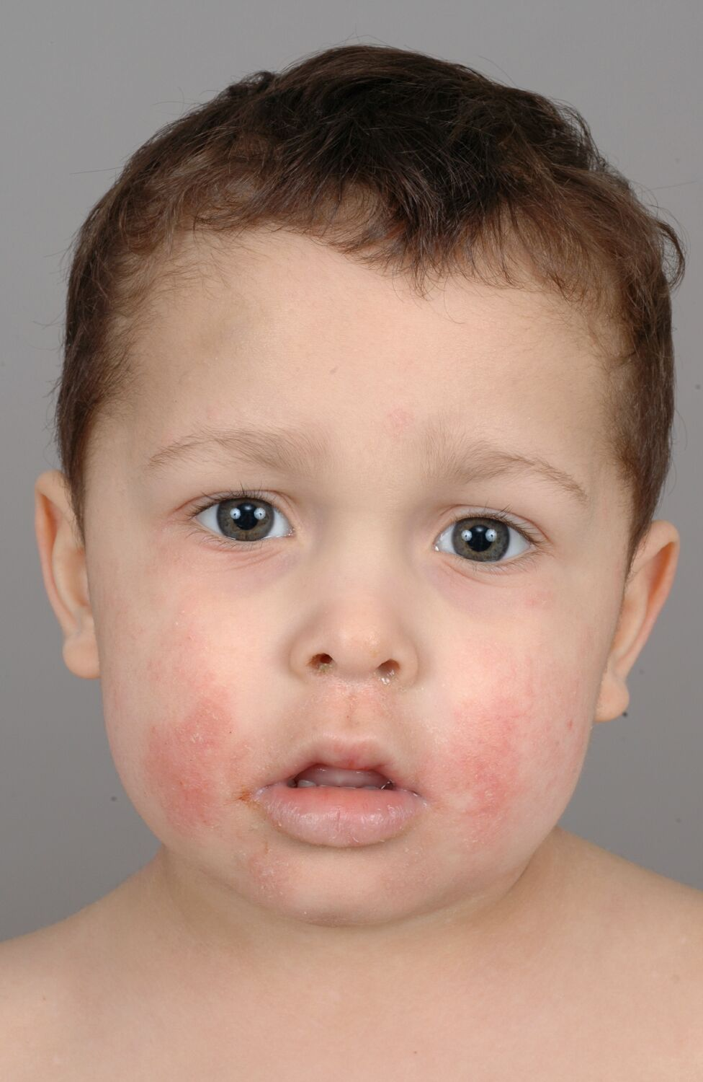
Slide 7

Slide 19
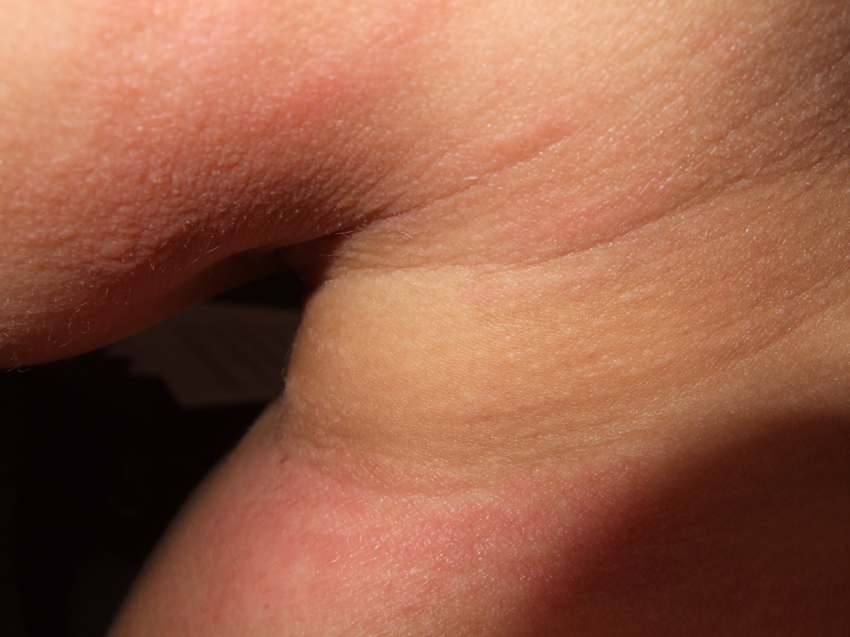
Slide 8

Slide 20
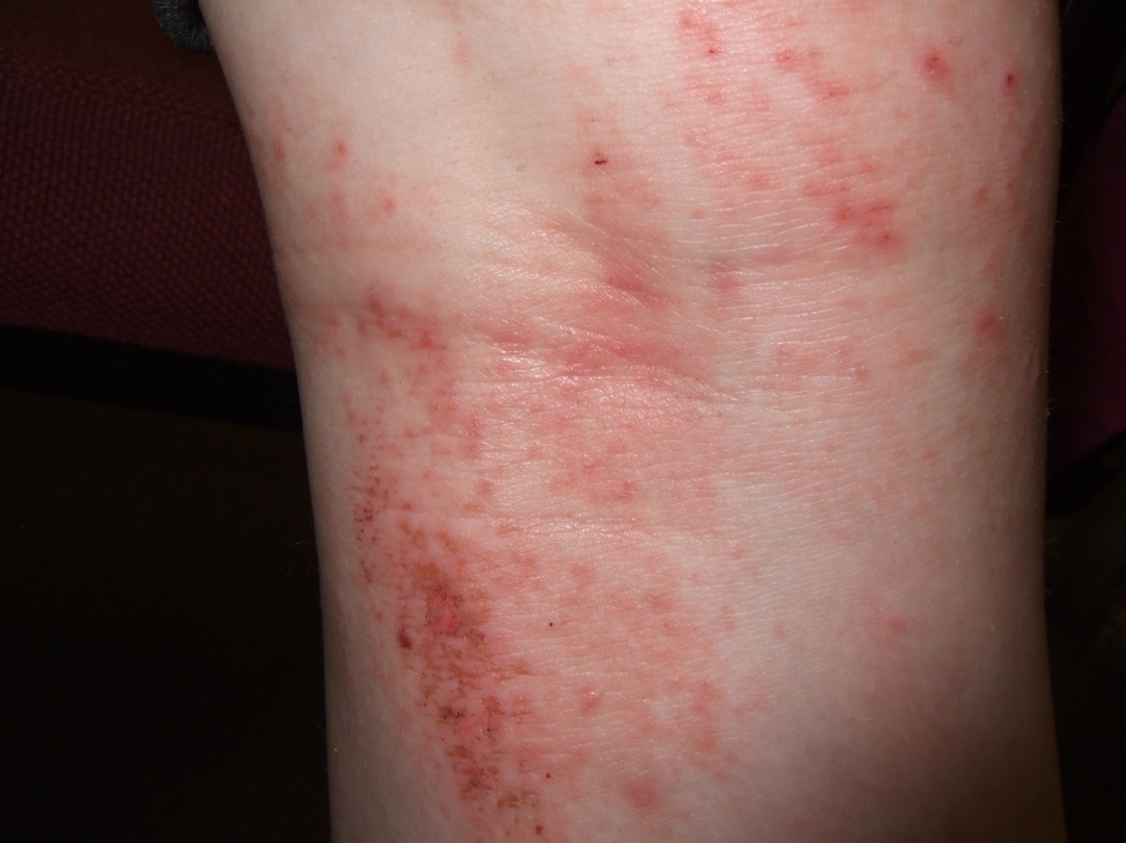
Slide 9

Slide 21
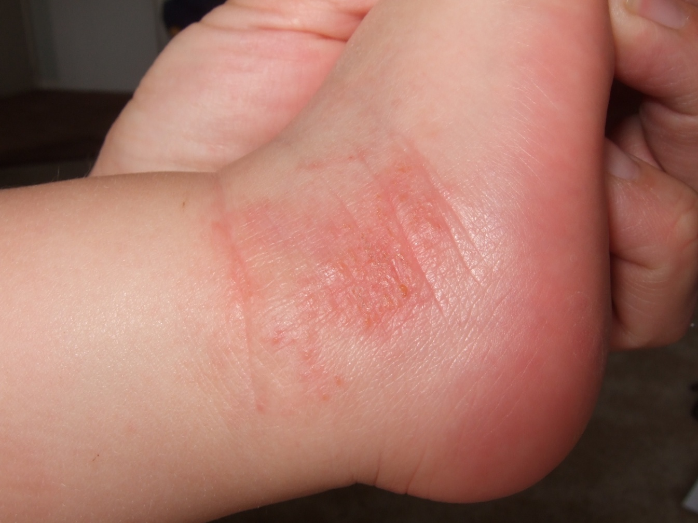
Slide 10

Slide 22
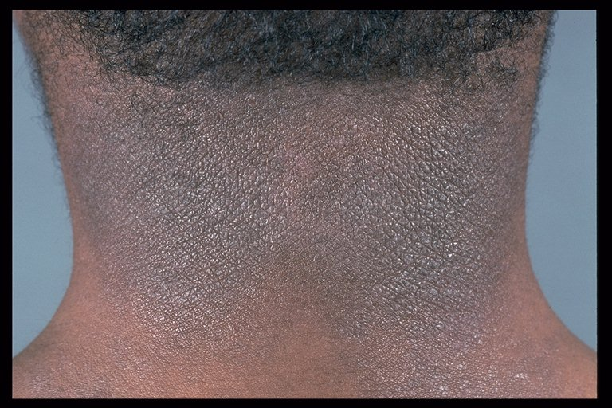
Slide 11

Slide 23
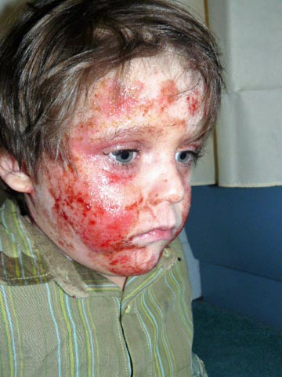
Slide 12

Slide 24
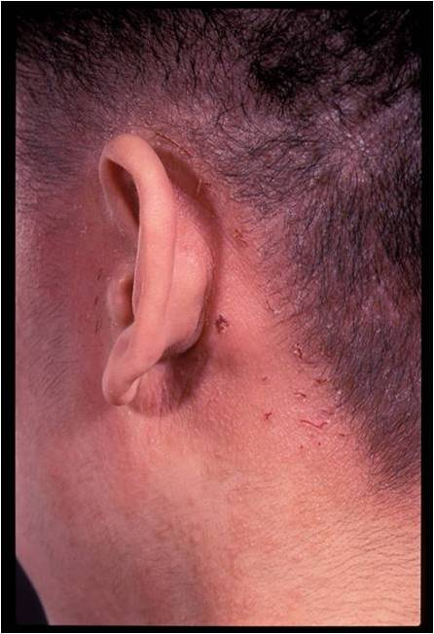
Slide 13

Slide 25
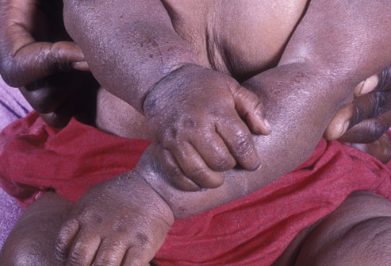
Slide 14

Slide 26
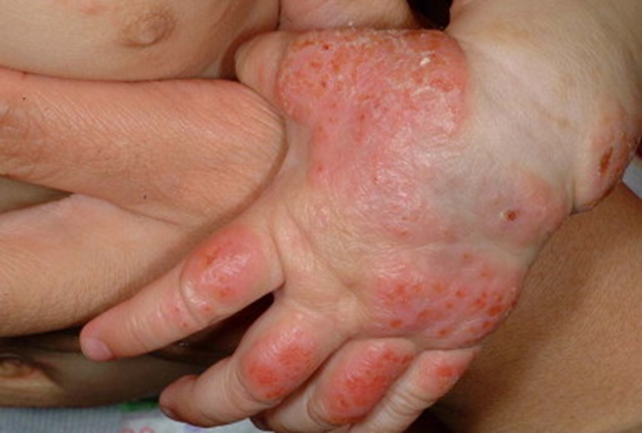
Slide 15

Slide 27
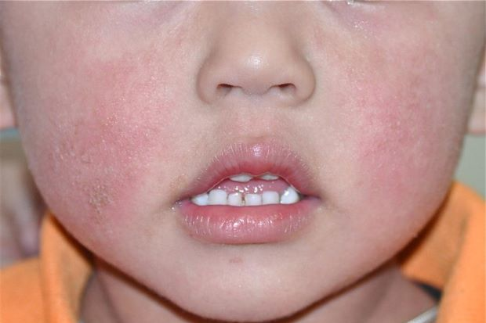
Slide 16

Slide 28
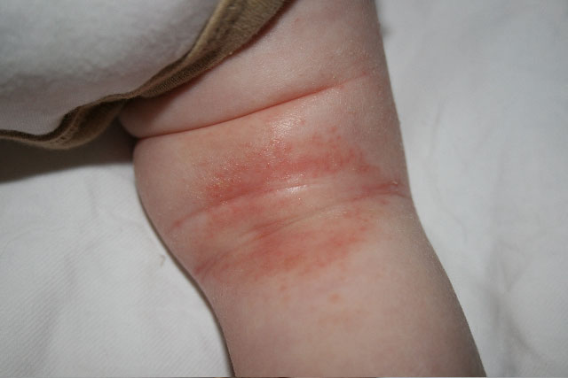
Slide 17

Slide 29
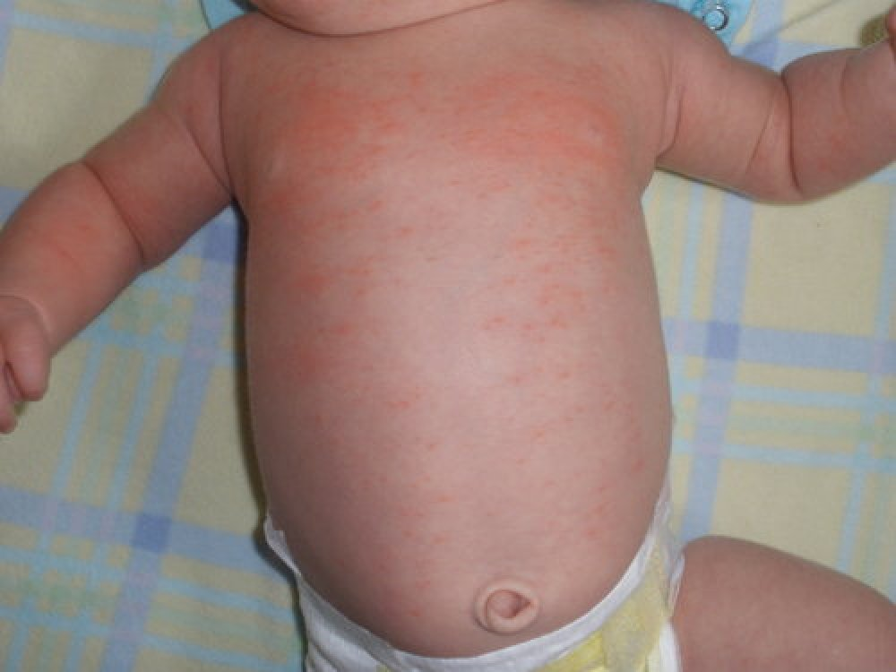
Slide 18

Slide 30
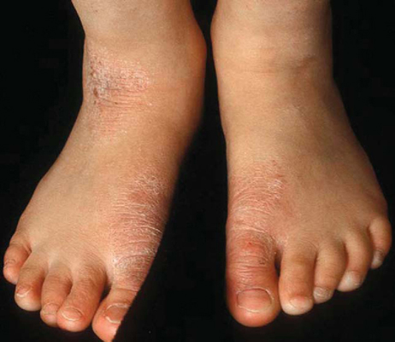
Slide 19

Slide 31
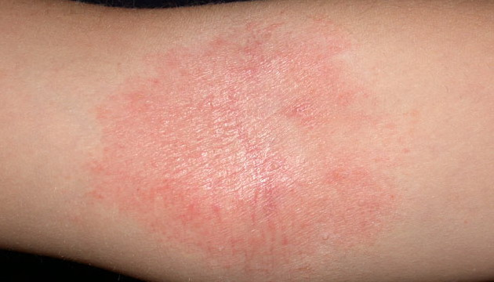
Slide 20

Slide 32
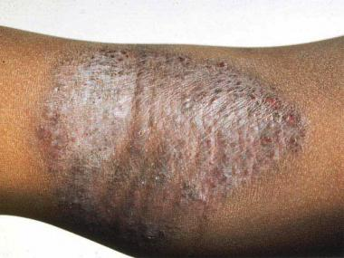
Slide 21

