Slide 1
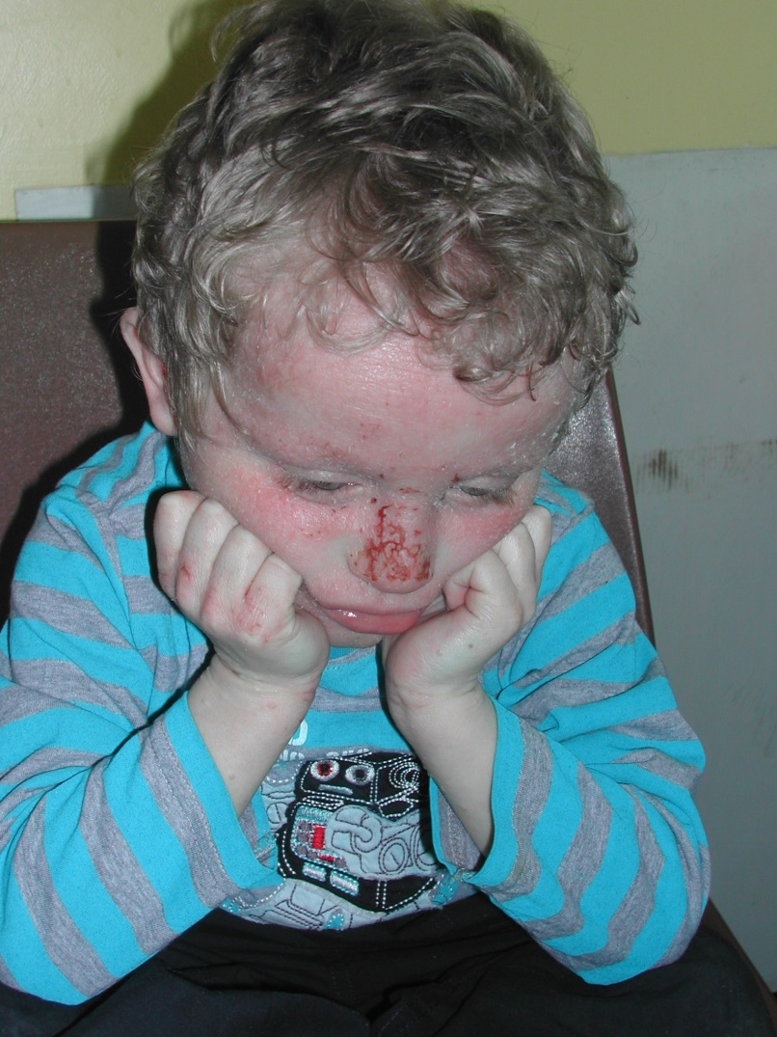
EASI practice images

Slide 2
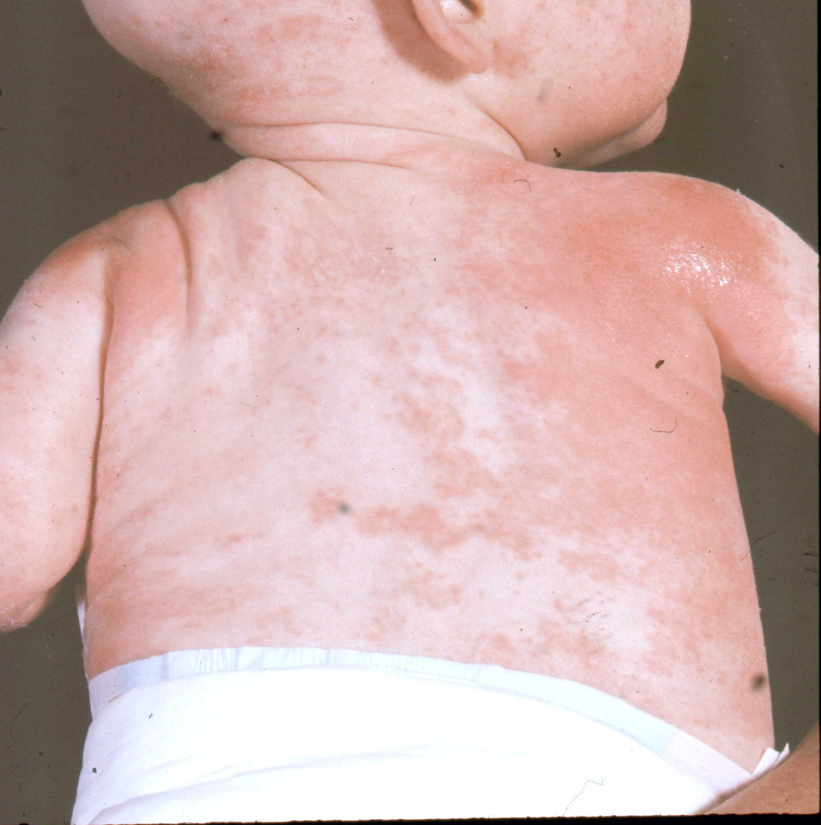
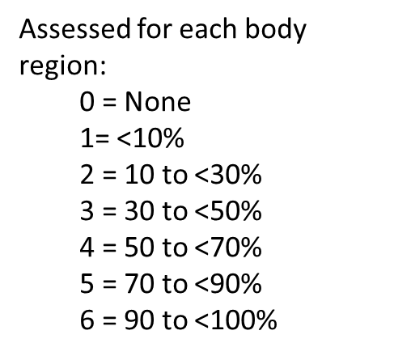
Start with some body surface area

Slide 3
Trunk

Slide 4
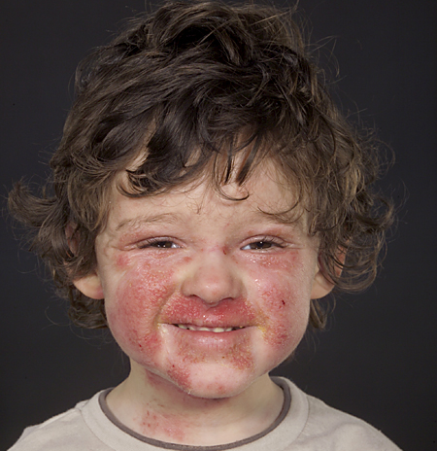

Slide 5
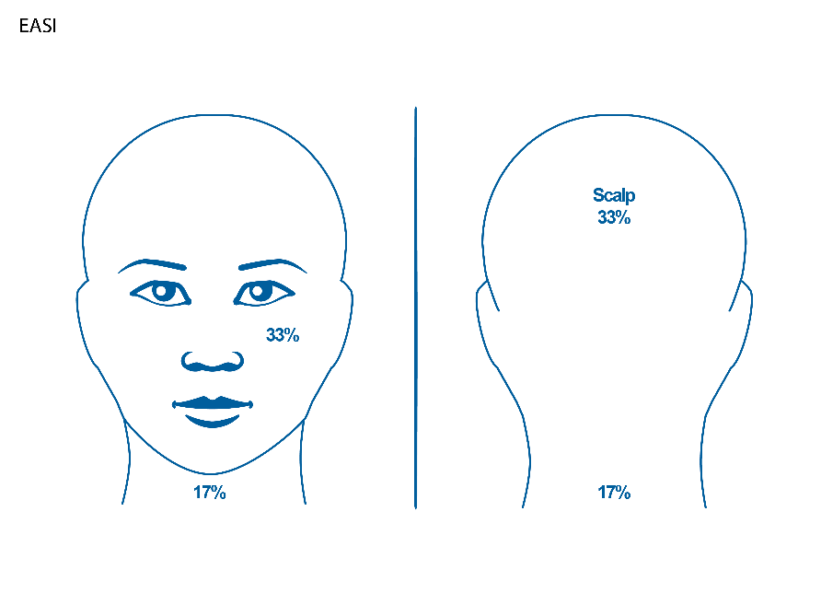

Slide 6
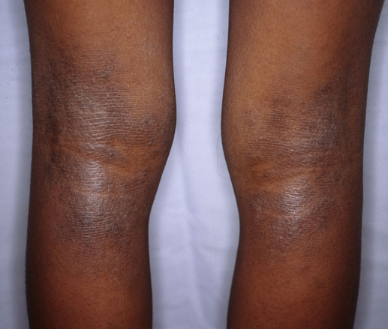

Slide 7
Lower extremities

Slide 8
Assess severity of 4 key signs in each body region
Erythema (redness)
Oedema / papulation (swelling and bumpiness)
Excoriation (scratch marks)
Lichenification (“leatheriness”)
Score the degree of severity of each sign for each body region separately
Take an average of the severity across the involved area Half points may be used e.g. 2.5 except when averaging 2 limbs 0.5 not used – either 1 or 0 Palpation may be useful in assessing oedema/papulation as well as lichenification
0 | None
1 | Mild
2 | Moderate
3 | Severe

Slide 9
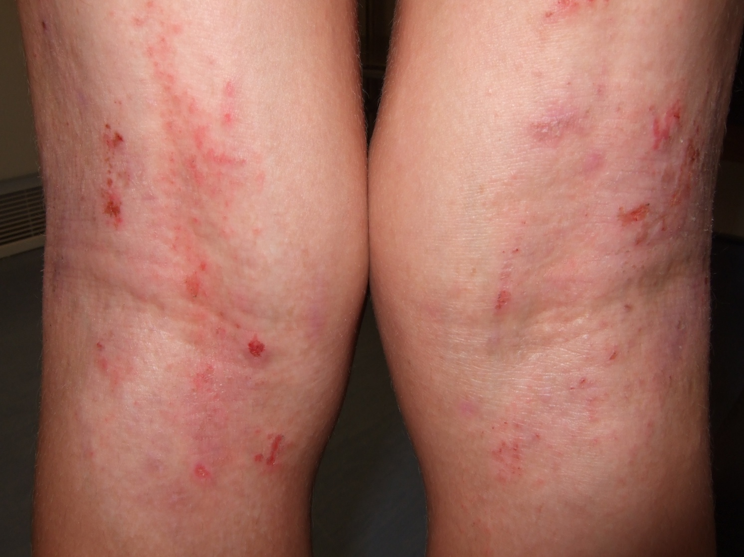
Let’s do the 4 intensity sign

Slide 10
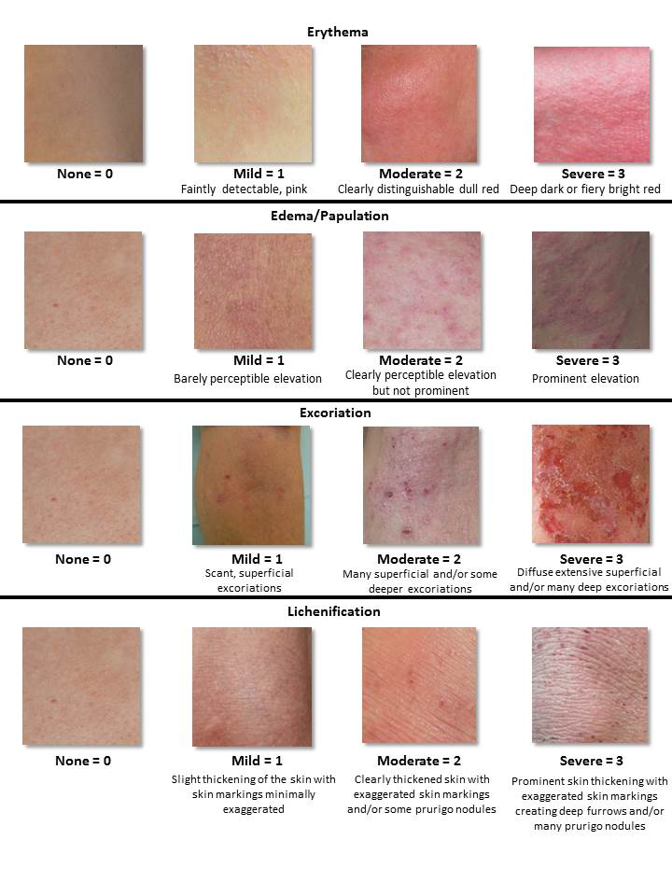
2
1
2
1
6

Slide 11
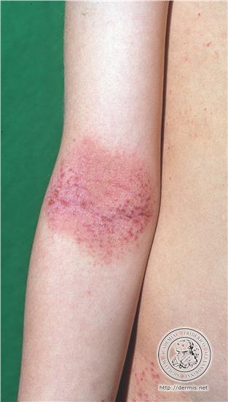

Slide 12
2
1
2
1
6

Slide 13
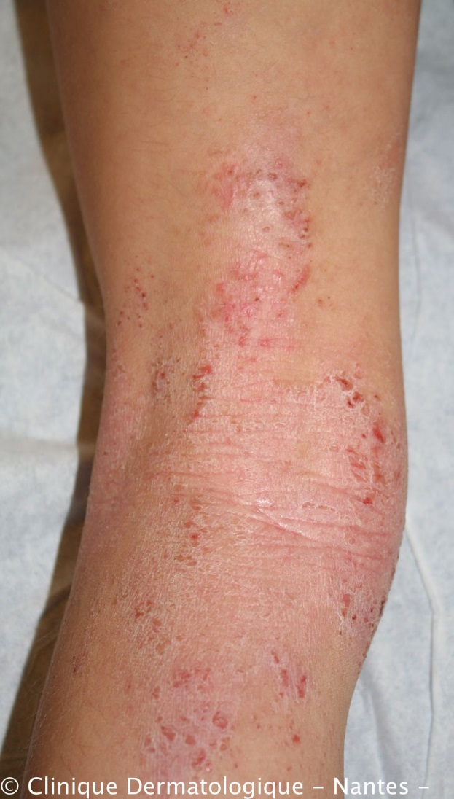

Slide 14
1
1
2
2
6

Slide 15
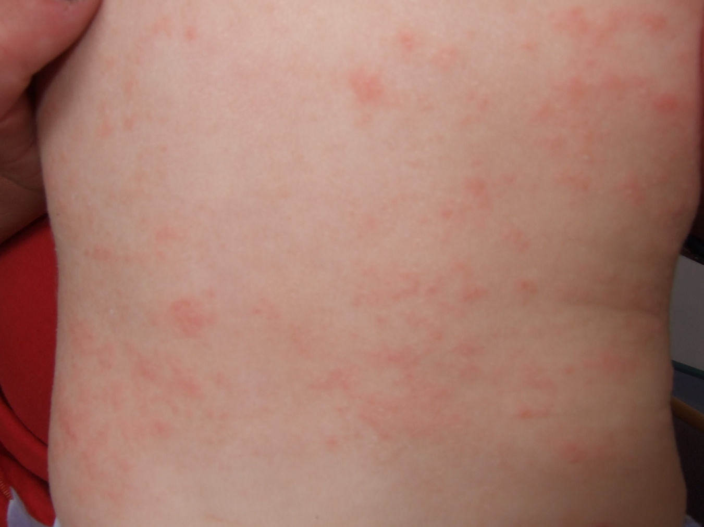
Now you try some: Slide 1:

Slide 16
1.5
1.5
0
0
3

Slide 17
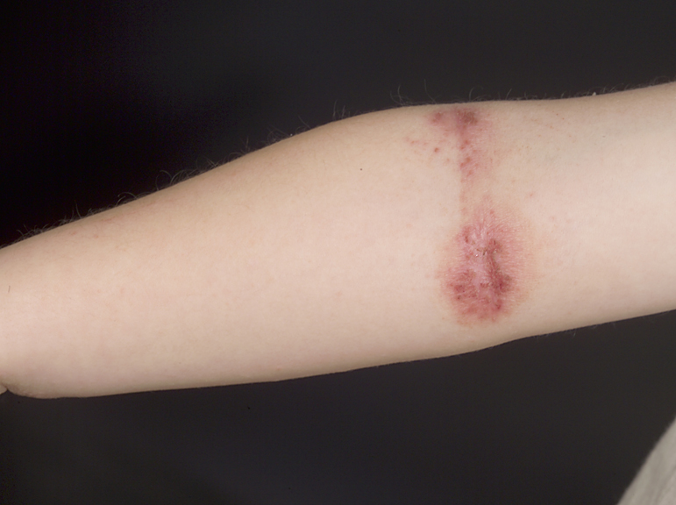
Slide 2

Slide 18
2
1
2
0
5

Slide 19
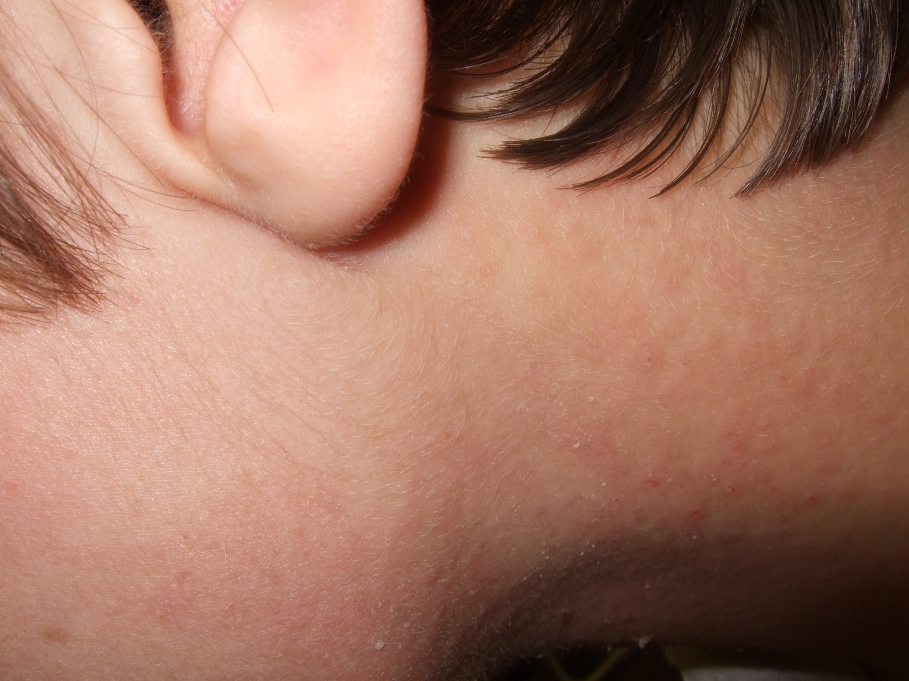
Slide 3

Slide 20
1
1
1
0
3

Slide 21
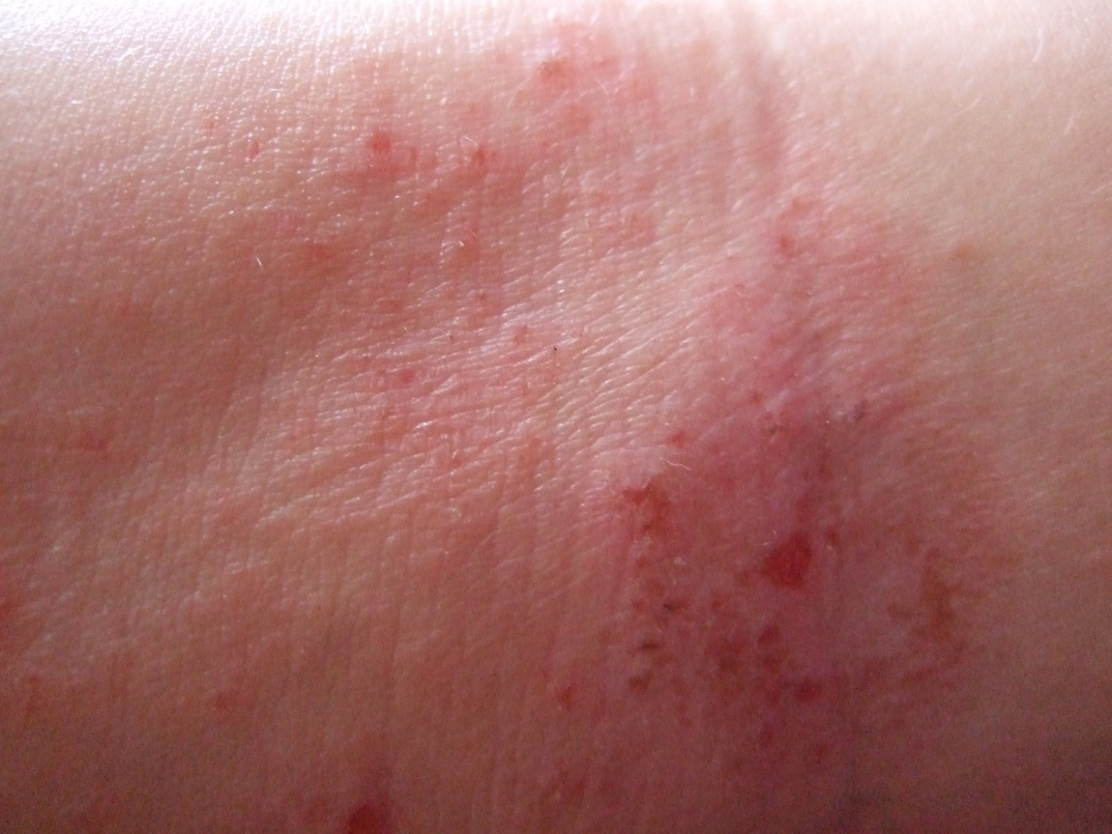
Slide 4

Slide 22
1
1
2
1
5

Slide 23
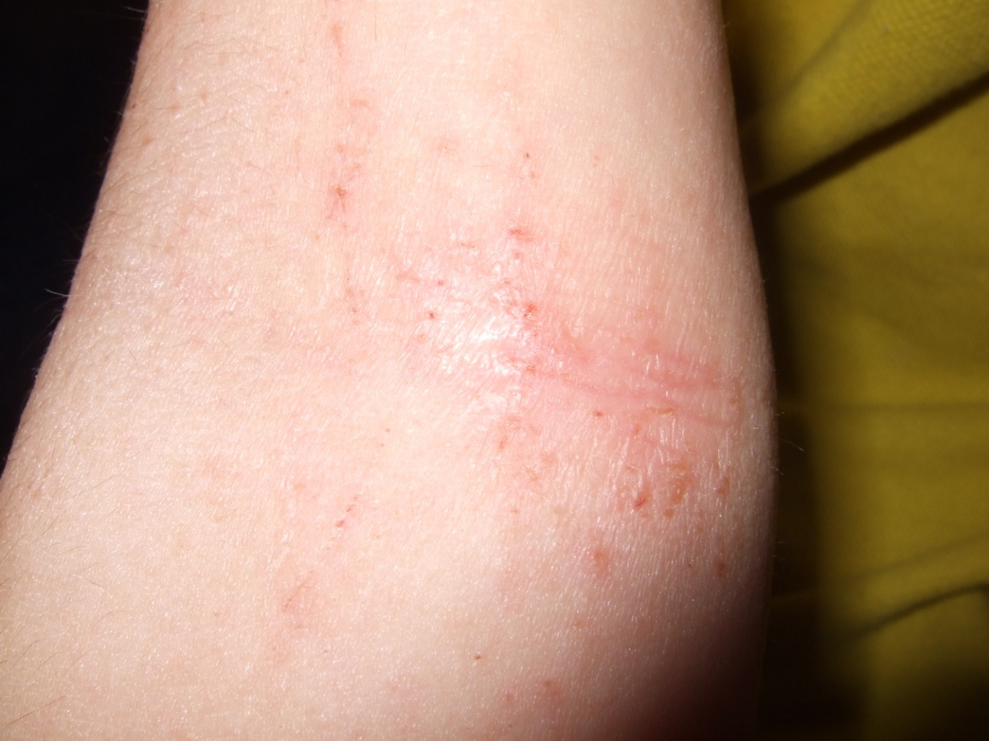
Slide 5

Slide 24
1
0
1
1
3

Slide 25
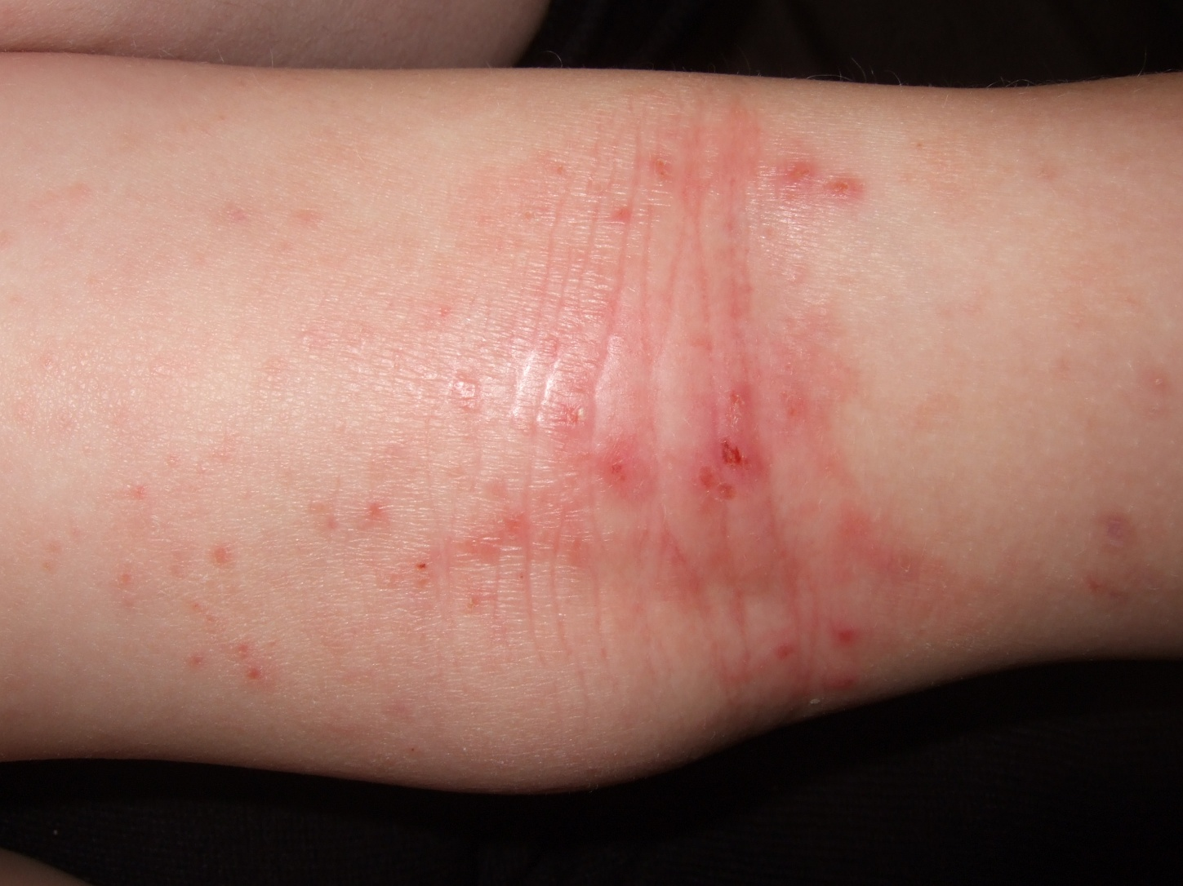
Slide 6

Slide 26
1.5
1
1.5
2
6

Slide 27
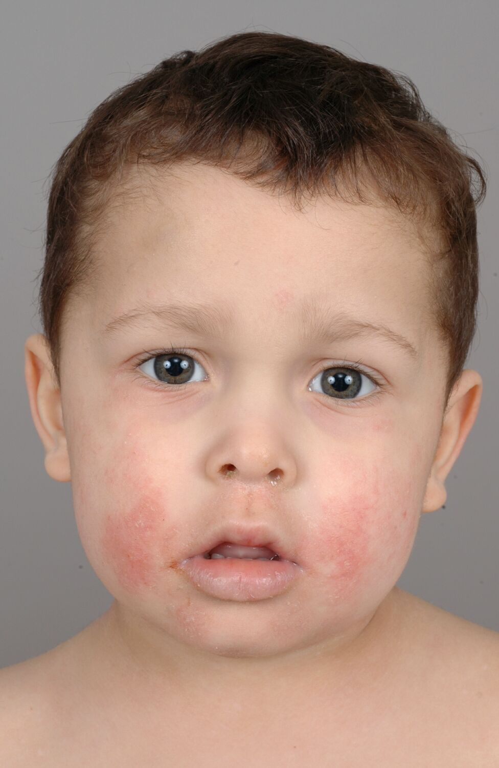
Slide 7

Slide 28
1
0
0
0
1

Slide 29
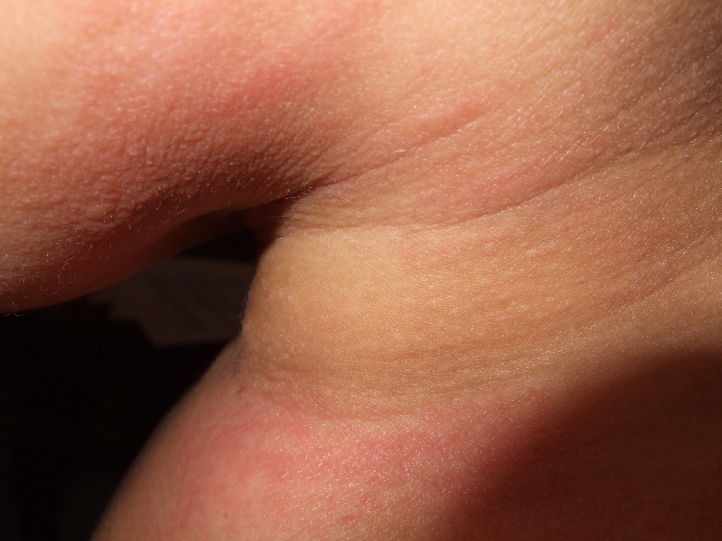
Slide 8

Slide 30
1.5
1
0
0
2.5

Slide 31
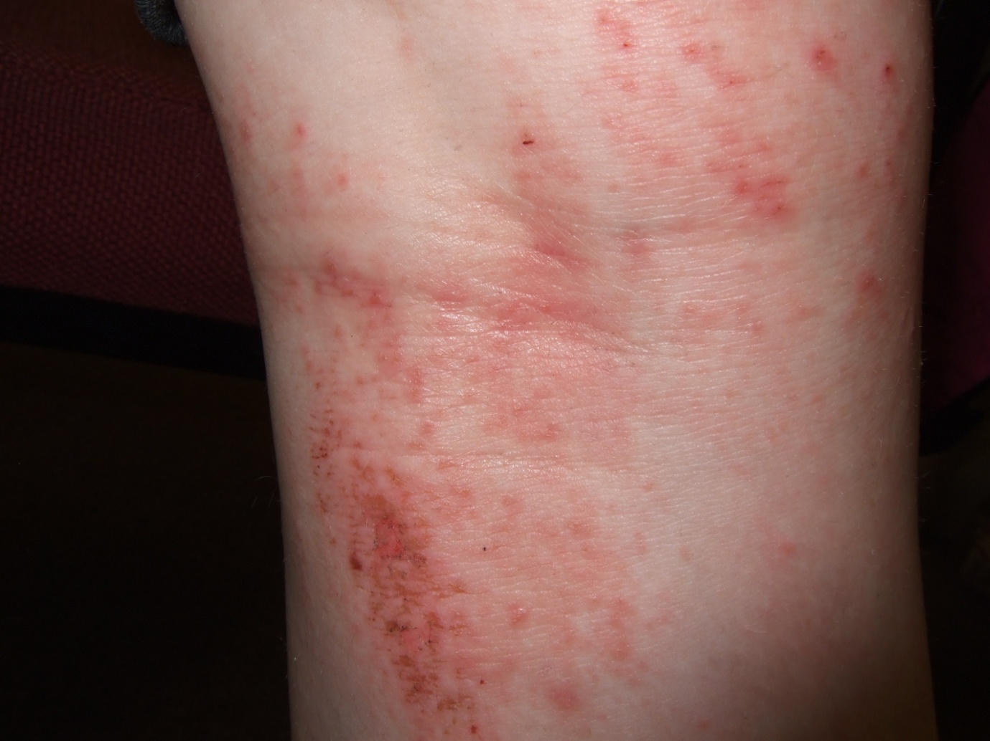
Slide 9

Slide 32
1.5
1
2
1
5.5

Slide 33
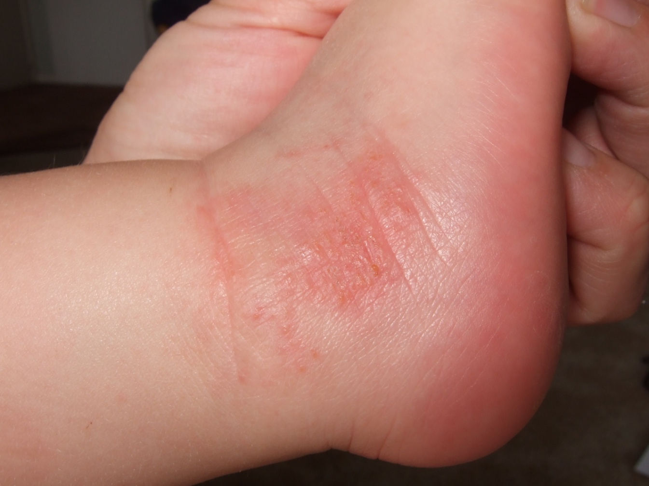
Slide 10

Slide 34
2
1
1
1
5

Slide 35
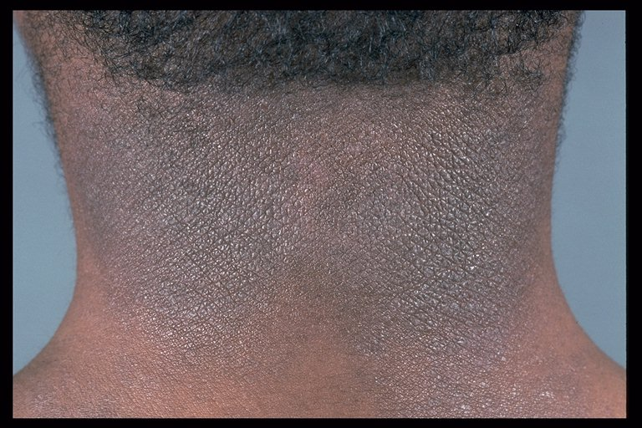
Slide 11

Slide 36
2
0
0
2
4

Slide 37
Slide 12

Slide 38
2.5
1
3
0
6.5

Slide 39
Slide 13

Slide 40
1
1
1
0
3

Slide 41
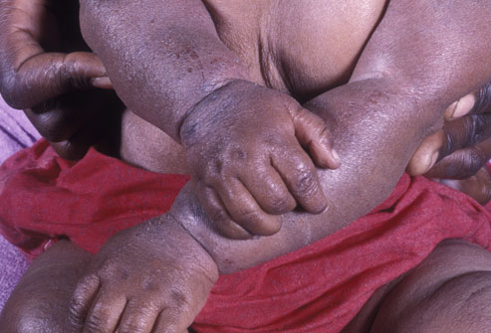
Slide 14

Slide 42
2
3
1
1
7

Slide 43
Slide 15

Slide 44
2
3
2
0
7

Slide 45
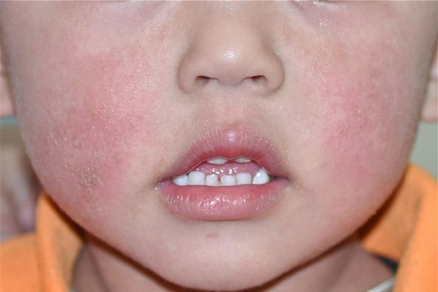
Slide 16

Slide 46
1
0
0
0
1

Slide 47
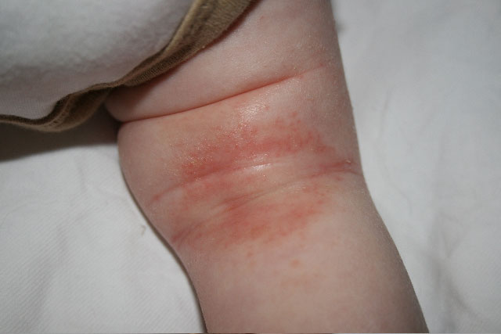
Slide 17

Slide 48
1.5
1
0
0
2.5

Slide 49
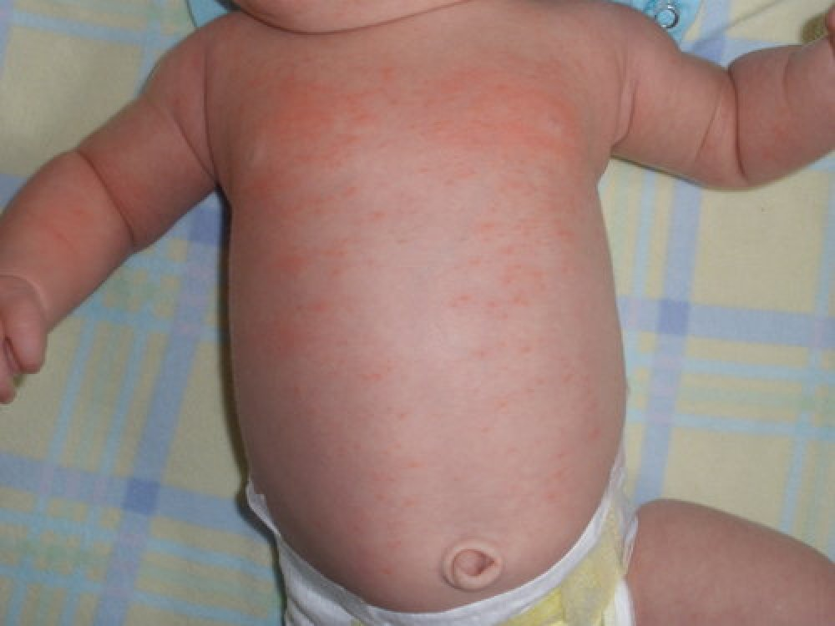
Slide 18

Slide 50
1.5
2
0
0
3.5

Slide 51
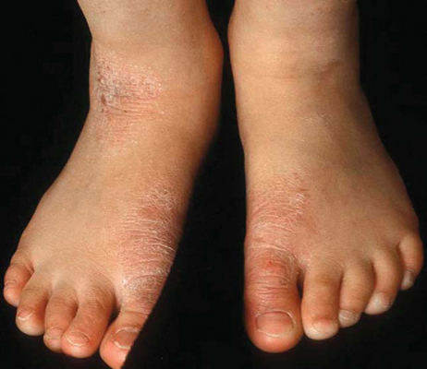
Slide 19

Slide 52
1
0
1
2
4

Slide 53
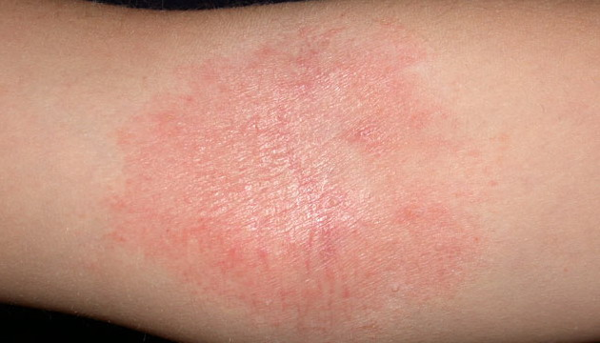
Slide 20

Slide 54
1.5
1
0
1
3.5

Slide 55
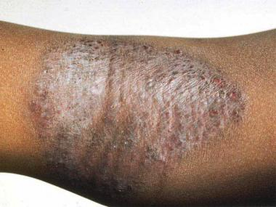
Slide 21

Slide 56
2
1.5
1.5
2
7.0

