Slide 1
Introduction to assessing the severity of eczema using EASI

Slide 2
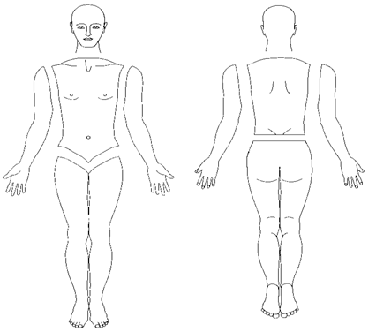
4 body regions
1 : Head/Neck
2: Trunk
3: Upper extremities
4: Lower extremities
1
1
1
2
2
2
2
3
2
3
3
2
3
2
2
2
2
3
3
3
3
4
4
4
4
4
4
4
4
4
4
4
4
Notes:
Split
Forearm
thigh

Slide 3
The EASI score
For each of the 4 body regions
1 : Head/Neck
2: Trunk
3: Upper extremities
4: Lower extremities
A
B
Percentage of surface affected by eczema
for each body region
Severity of 4 key signs for each body region
Erythema (redness)
Oedema / papulation
Excoriation (scratching)
Lichenification
e.g. 50% of head and neck area is affected by eczema
No requirement to add up the surface area of different body regions

Slide 4
The EASI score
For each of the 4 body regions 1 : Head/Neck
2: Trunk
3: Upper extremities
4: Lower extremities
B
Severity of 4 key signs for each body region
Erythema (redness)
Oedema / papulation
Excoriation (scratching)
Lichenification

Slide 5
Assess severity of 4 key signs in each body region
Erythema (redness)
Oedema / papulation (swelling and bumpiness)
Excoriation (scratch marks)
Lichenification (“leatheriness”)
Score the degree of severity of each sign for each body region separately
Take an average of the severity across the whole body region Half points may be used e.g. 2.5 Remember 2 limbs = one body region Palpation may be useful in assessing oedema/papulation as well as lichenification
0 | None
1 | Mild
2 | Moderate
3 | Severe

Slide 6
Scoring table - severity
Body region | Erythema (0-3) | Oedema / papulation (0-3) | Excoriation (0-3) | Lichenification (0-3)
Head/neck
Trunk
Upper extremities
Lower extremities

Slide 7
Erythema (redness) assessed by visual examination

Slide 8
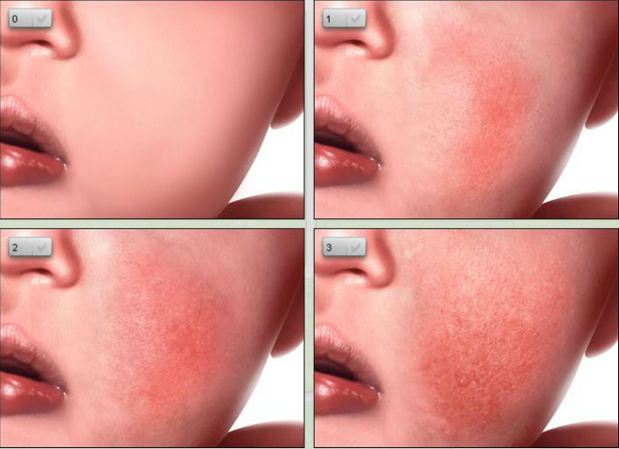
Erythema (redness)
PO SCORAD training
www.opened-dermatology.com

Slide 9
2. Oedema/papulation assessments by palpation and visual examination

Slide 10
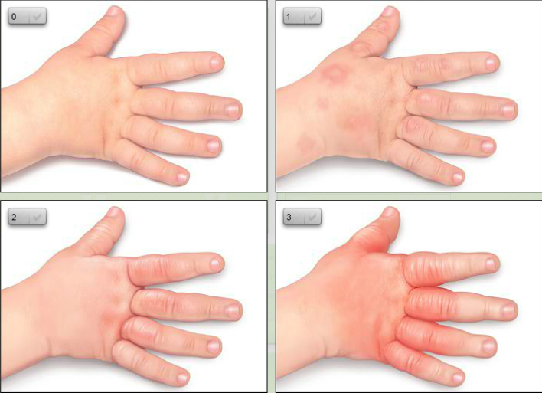
Oedema
PO SCORAD training
www.opened-dermatology.com

Slide 11
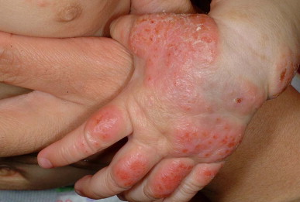

Slide 12
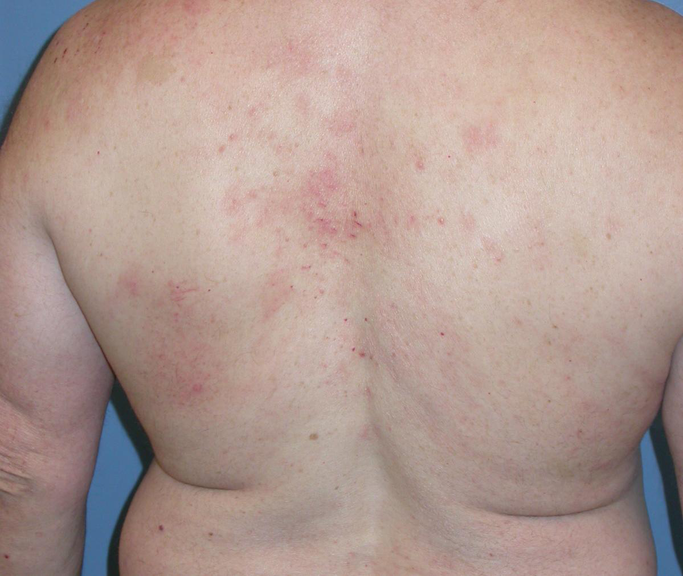

Slide 13
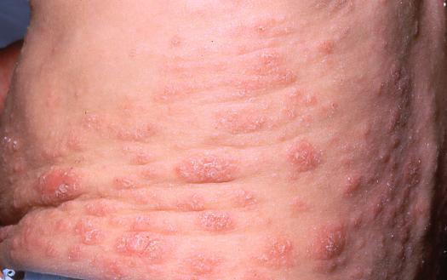

Slide 14
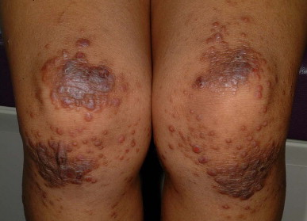

Slide 15
Excoriation (scratching)

Slide 16
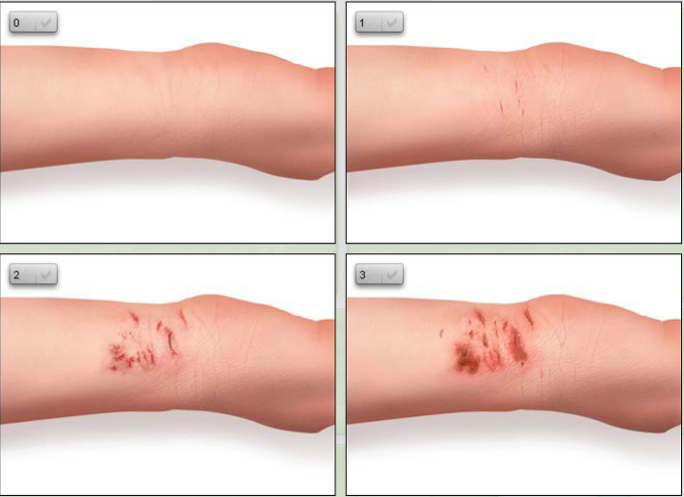
3. Excoriation (scratching)
PO SCORAD training
www.opened-dermatology.com

Slide 17
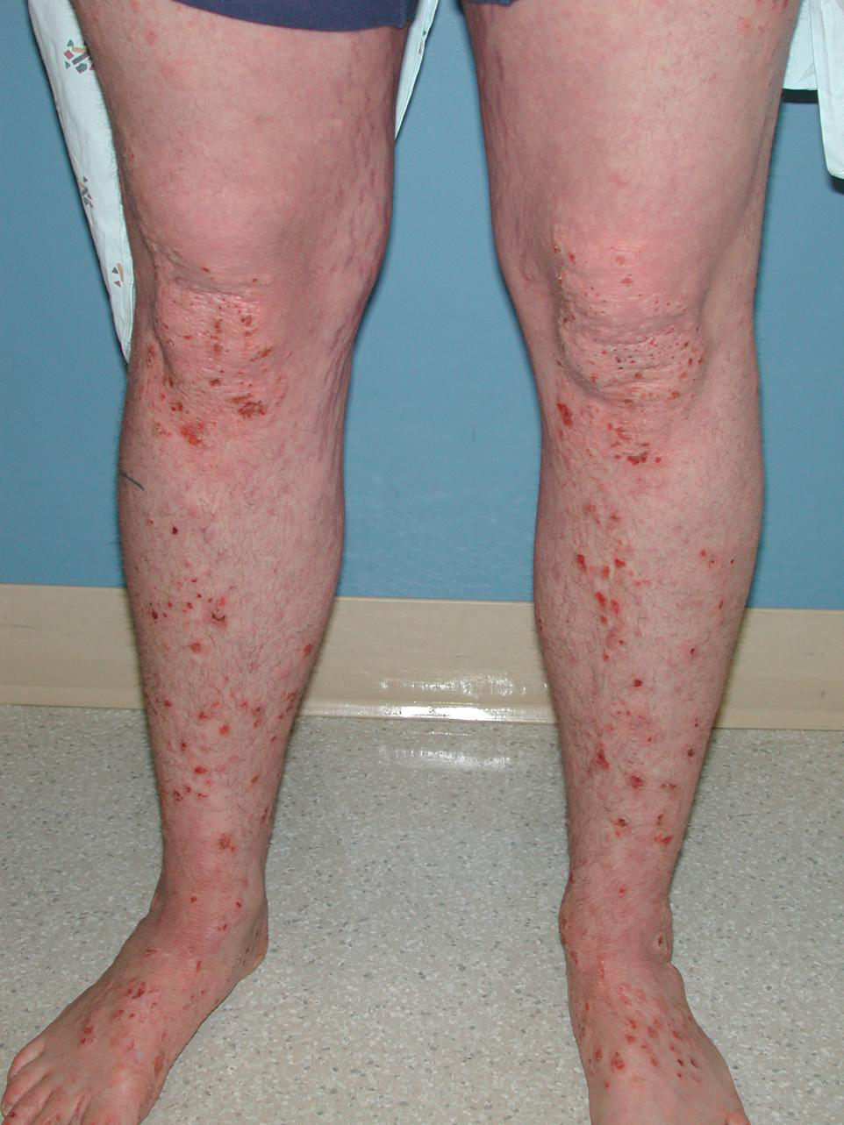

Slide 18
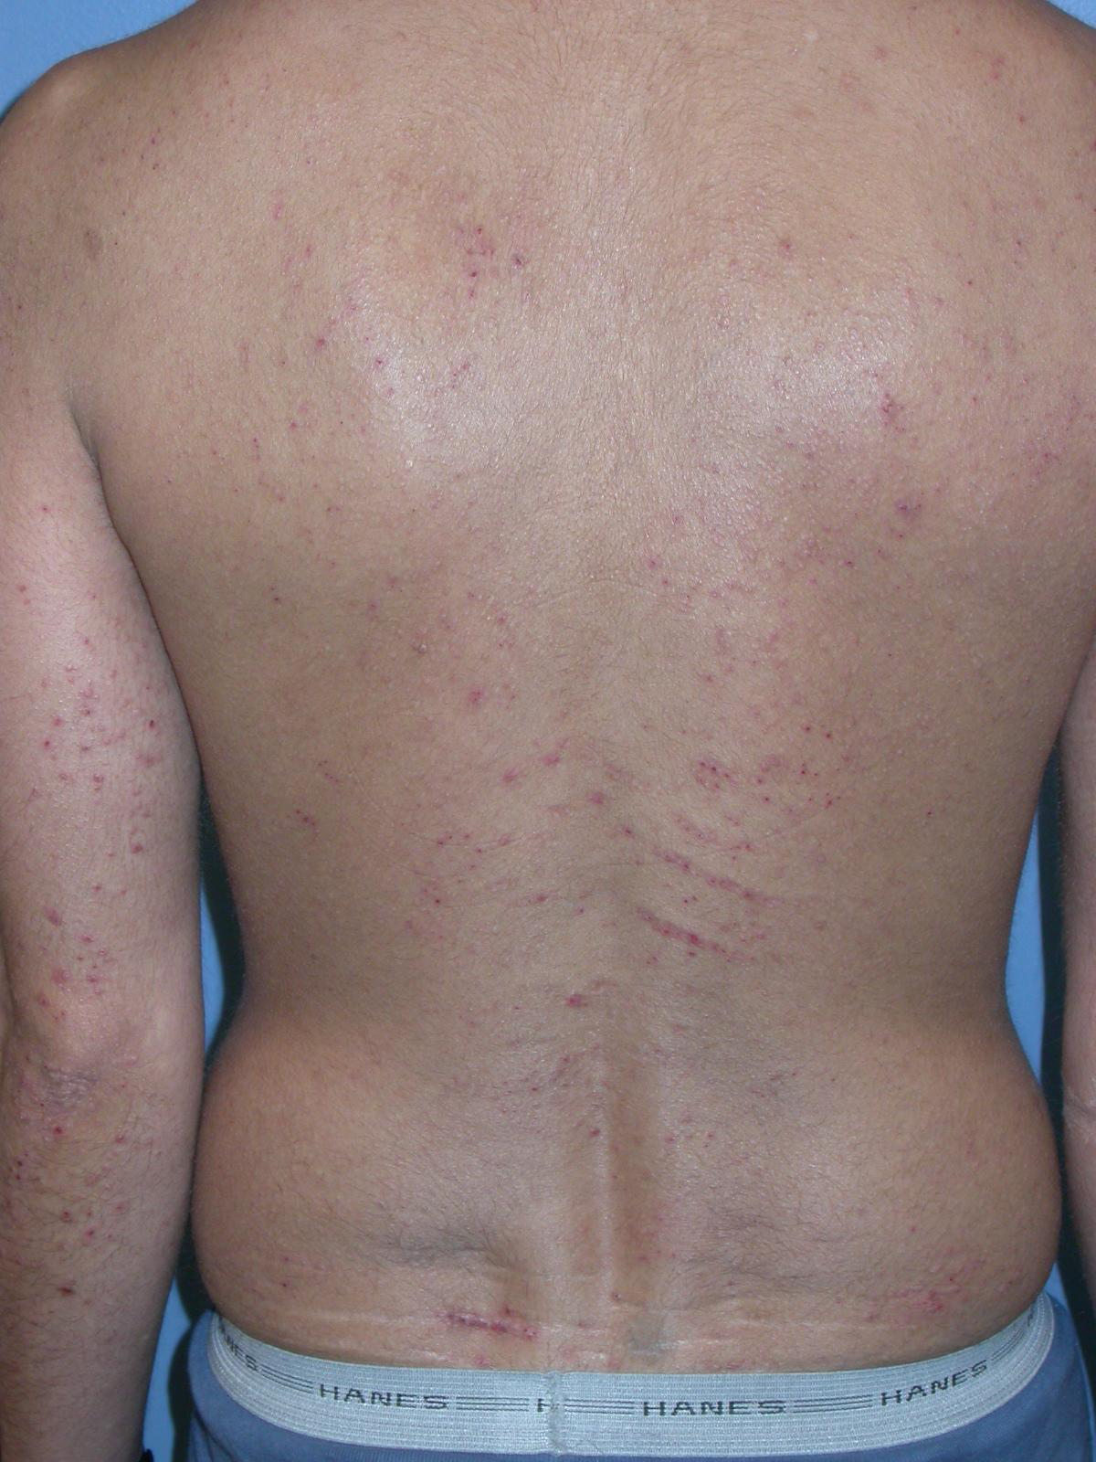

Slide 19
4. Lichenification assessments by palpation and visual examination

Slide 20
Lichenification
PO SCORAD training
www.opened-dermatology.com

Slide 21
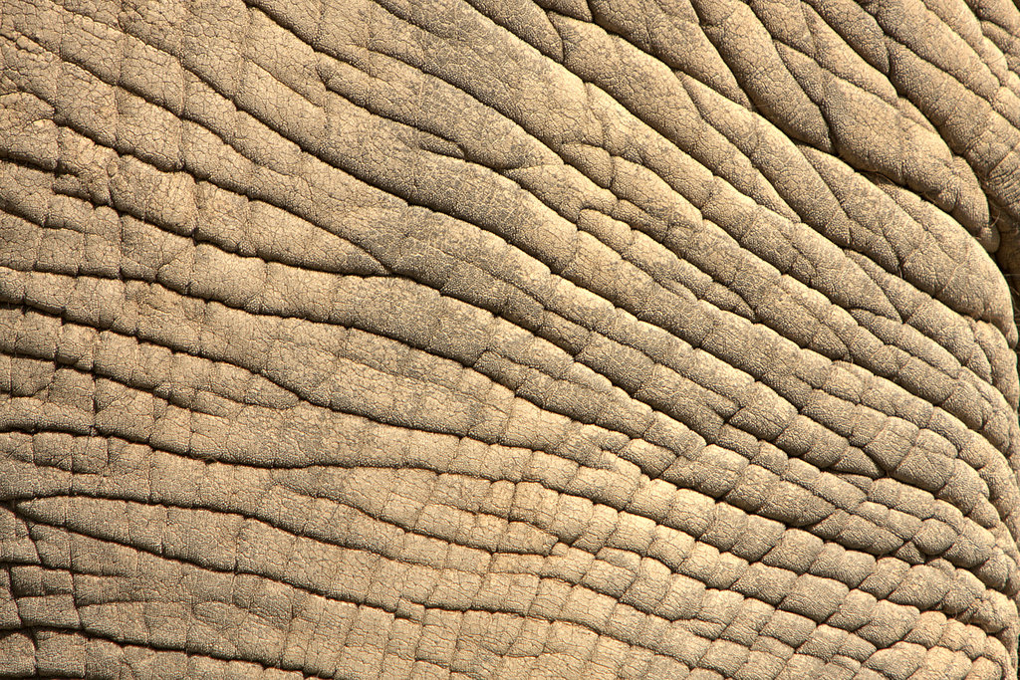
Lichenification (“elephant skin”)

Slide 22
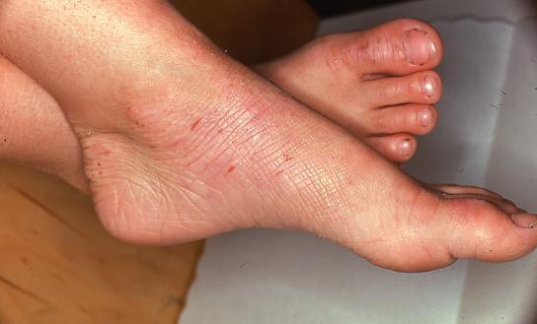

Slide 23
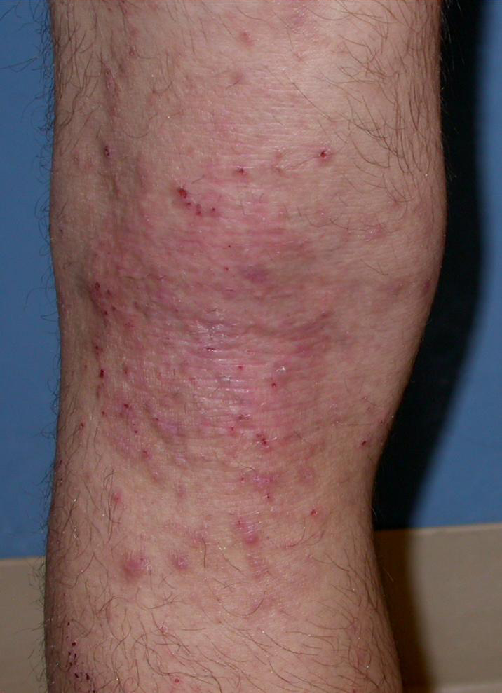

Slide 24
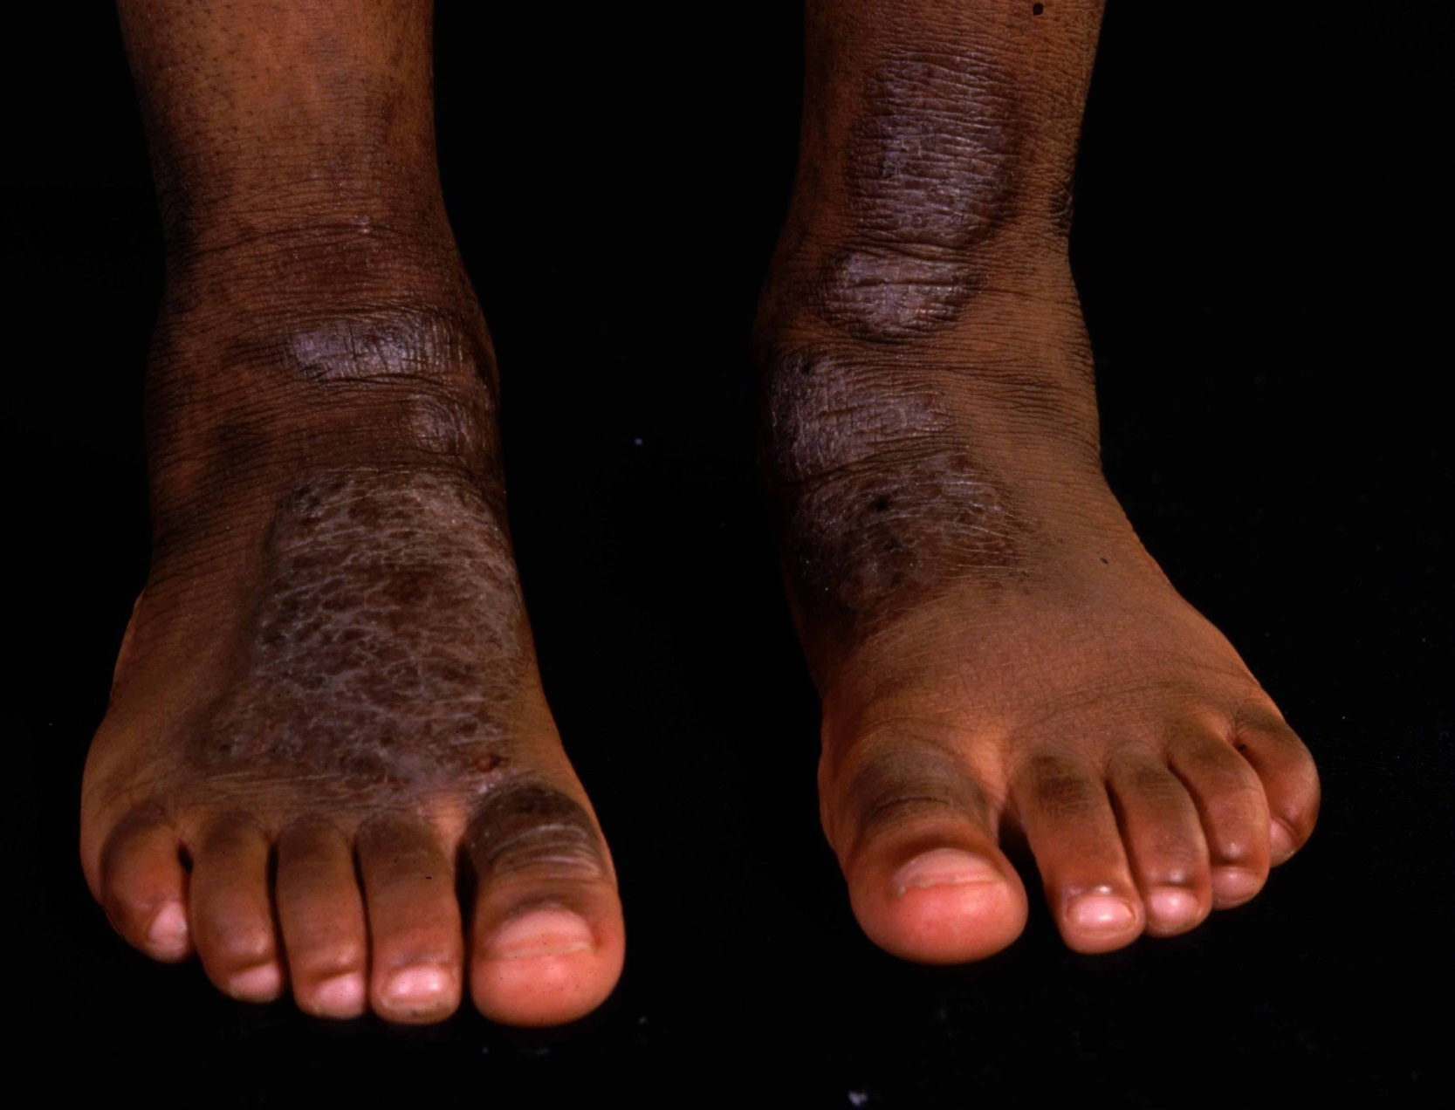

Slide 25
What if there are patches with different severity in the same body region?
E.g. In upper extremities
One patch scores 2 for redness
Another patch scores 3 for redness
the average severity for redness in this body region will be 2.5
Notes:
Need to check with Kim whether 0.5 was accepted in CLOTHES or whether 1 is minimum score f
for presence of any sign?

Slide 26
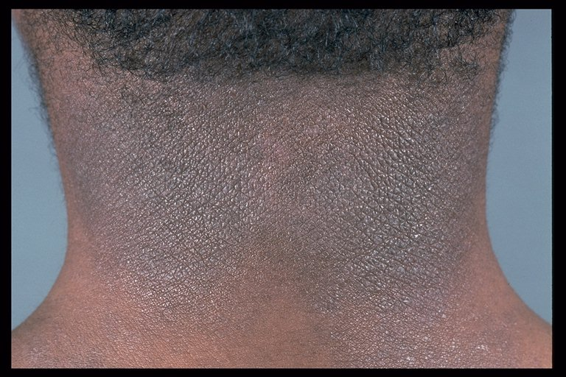
Eczema on dark skin

Slide 27
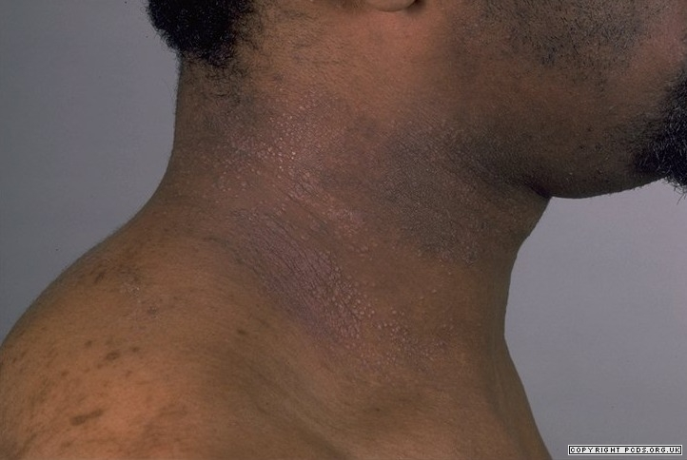
Eczema on dark skin

Slide 28
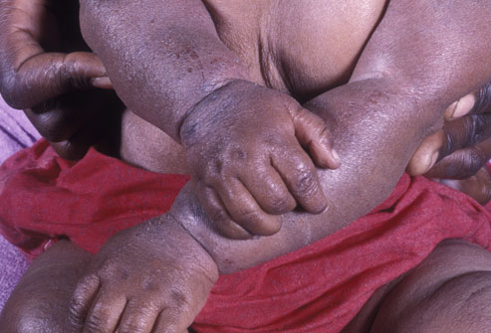

Slide 29
The EASI score
For each of the 4 body regions
1 : Head/Neck
2: Trunk
3: Upper extremities
4: Lower extremities
A
B
Percentage of surface affected by eczema
for each body region
Severity of 4 key signs for each body region
Erythema (redness)
Oedema / papulation
Excoriation (scratching)
Lichenification
e.g. 50% of head and neck area is affected by eczema
No requirement to add up the surface area of different body regions

Slide 30
The EASI score
For each of the 4 body regions
1 : Head/Neck
2: Trunk
3: Upper extremities
4: Lower extremities
A
Percentage of Surface affected by eczema
for each body region
e.g. 50% of head and neck area is affected by eczema
No requirement to add up the surface area of different body regions

Slide 31
Tip - don’t get too hung up on accuracy – broad bands are used
4 body regions
1 : Head/Neck
2: Trunk
3: Upper extremities
4: Lower extremities
1
1
1
2
2
2
2
3
2
3
3
2
3
2
2
2
2
3
3
3
3
4
4
4
4
4
4
4
4
4
4
4
4

Slide 32
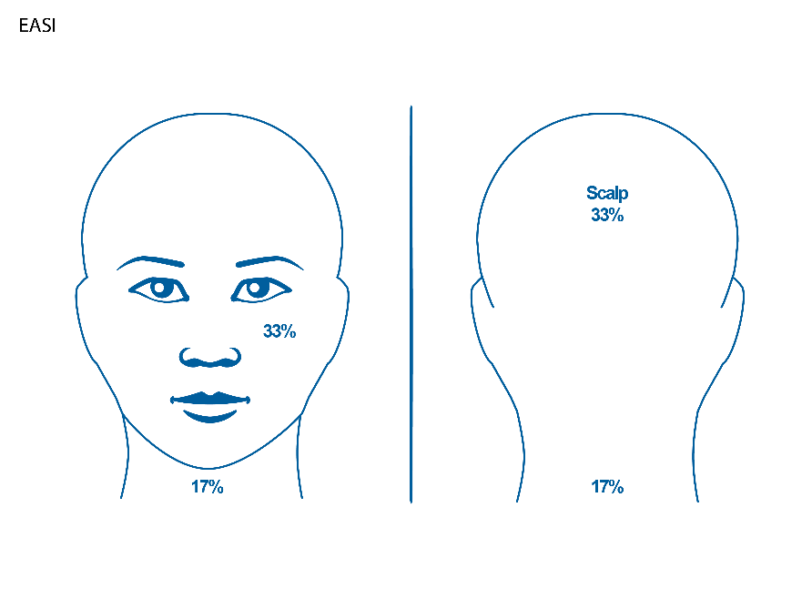
Head and Neck – start by using these percentages to guide you

Slide 33
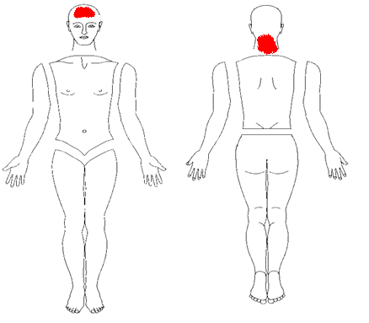
Percentage of Surface affected by eczema
for each body region
Head/Neck
11% ie 1/3 of 33%
17%
ie all of back of neck which is 17%
Assessed for each body region:
0 = None
1= <10%
2 = 10 to <30%
3 = 30 to <50%
4 = 50 to <70%
5 = 70 to <90%
6 = 90 to <100%
Head/Neck : 27% = 2

Slide 34
Trunk

Slide 35
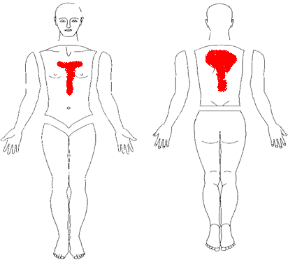
Percentage of Surface affected by eczema
for each body region
Trunk
Assessed for each body region:
0 = None
1= <10%
2 = 10 to <30%
3 = 30 to <50%
4 = 50 to <70%
5 = 70 to <90%
6 = 90 to <100%
11% ie about 1/5 of 55%
15% ie about 1/3 of 45%
Trunk : 26 % = 2
Tip: you can “eyeball” whole area if you like, but tendency will be to overestimate

Slide 36
Upper extremities

Slide 37
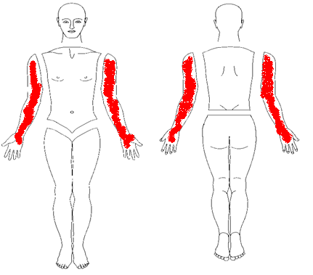
Percentage of Surface affected by eczema
for each body region
Upper extremities
Assessed for each body region:
0 = None
1= <10%
2 = 10 to <30%
3 = 30 to <50%
4 = 50 to <70%
5 = 70 to <90%
6 = 90 to <100%
Upper extremities : 95 % = 6

Slide 38
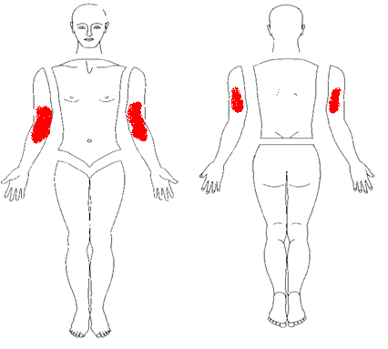
Percentage of Surface affected by eczema
for each body region
Upper extremities
Assessed for each body region:
0 = None
1= <10%
2 = 10 to <30%
3 = 30 to <50%
4 = 50 to <70%
5 = 70 to <90%
6 = 90 to <100%
8+8 =16
4+4=8
Upper extremities : 24% = 2
Tip: If you really can’t work out rough % in your head, just imagine how many times the red area can be copied into the total area to fill it

Slide 39
Lower extremities

Slide 40
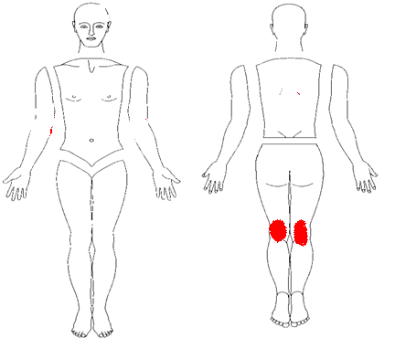
Percentage of Surface affected by eczema
for each body region
Lower extremities
Assessed for each body region:
0 = None
1= <10%
2 = 10 to <30%
3 = 30 to <50%
4 = 50 to <70%
5 = 70 to <90%
6 = 90 to <100%
4+4=8
Lower extremities: 8% = 1

